Slide 1
A First Principles Approach to Energy, Environment & Money in Macroeconomics
www.patreon.com/profstevekeen
www.profstevekeen.com

Slide 2
Outline
A First Principles Approach to
  Incorporating Energy into models of production
  Integrating Economics and Ecology
    Discussion
  The macroeconomic significance of bank-originated money and debt (“BOMD”)
  Deriving macroeconomics from incontrovertible macrofoundations foundations
    Discussion

Slide 3
Incorporating Energy into models of production
  The Laws of Thermodynamics:
    “If someone points out to you that your pet theory of the universe is in disagreement with Maxwell’s equations
      then so much the worse for Maxwell’s equations.
    If it is found to be contradicted by observations
      well, these experimentalists do bungle things sometimes.
    But if your theory is found to be against the second law of thermodynamics
      I can give you no hope;
      there is nothing for it but to collapse in deepest humiliation.”
        (Arthur Eddington, The Nature Of The Physical World, 1928, p.37)

Slide 4
Incorporating Energy into models of production
All of the Universe obeys the “Laws of Thermodynamics”. Colloquially:
  First Law: Conservation. “Energy can neither be created nor destroyed”
  Second Law: Entropy. “Disorder increases over time”
  Third Law: Waste. “100% conversion of energy into work requires a waste sink at Absolute Zero, and there is no such place”
Therefore the order of any Closed System degrades over time
Production & economic growth means increased order over time:
  More outputs than inputs
  Outputs (steel) have increased order over inputs to production (iron ore & coal)
For this to happen, there must be external sources of energy: an Open System
  Which drives a local decrease in entropy
    While causing global increase in entropy, to be consistent with 2nd Law
All existing economic models of production violate the Laws of Thermodynamics…

Slide 5
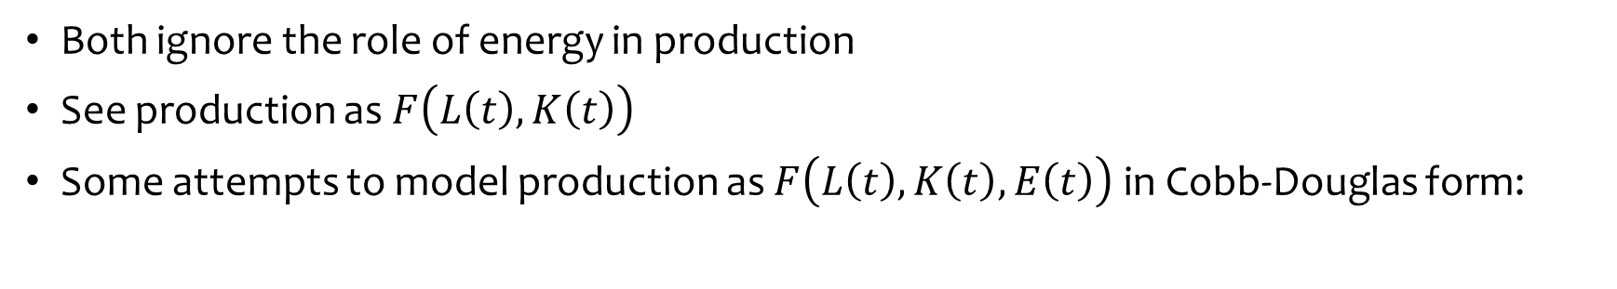
Incorporating Energy into models of production
Mathematical models of production began with Cobb-Douglas (1928)
Inputs Labour (L) and Capital (K) to produce output (Q) with constant returns to scale
Leontief production function (used by Post Keynesians):
Both ignore the role of energy in production
See production as $F\left(L\left(t\right),K\left(t\right)\right)$
Some attempts to model production as $F\left(L\left(t\right),K\left(t\right),E\left(t\right)\right)$ in Cobb-Douglas form:

Slide 6
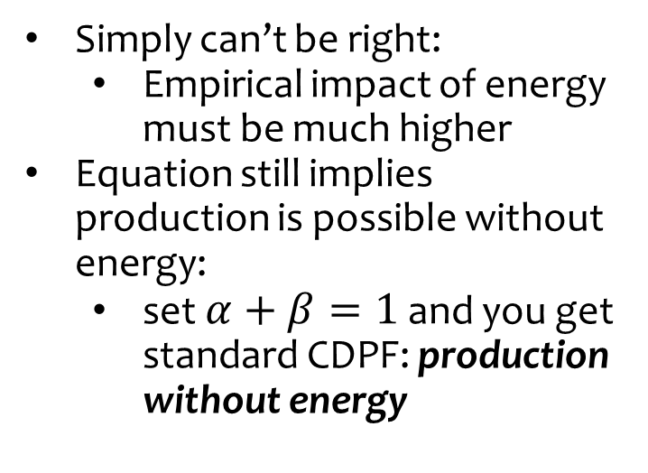
Incorporating Energy into models of production
Better, but gives trivial role to Energy when “cost share theorem” sets exponents
With $α=0.33,β=0.6,1−α−β=0.07$, 10% fall in energy causes only 0.7% fall in Q
90% fall in energy input…
Only 15% fall in output…
Simply can’t be right:
  Empirical impact of energy must be much higher
Equation still implies production is possible without energy:
  set $α+β=1$ and you get standard CDPF: production without energy

Slide 7
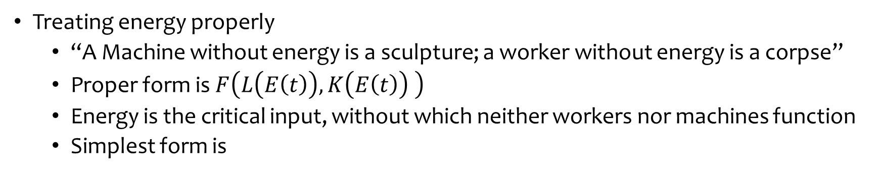
Incorporating Energy into models of production
Treating energy properly
  “A Machine without energy is a sculpture; a worker without energy is a corpse”
  Proper form is $F\left(L\left(E\left(t\right)\right),K\left(E\left(t\right)\right) \right)$
  Energy is the critical input, without which neither workers nor machines function
  Simplest form is
Units of Unskilled Labour (hours/Year)
Energy inputs to “representative worker” (Joules/Year)
Exergy ratio: ratio of useful work to energy input
“Units” of machinery (hours/Year)
Energy inputs to “representative machine” (Joules/Year)
Exergy ratio: ratio of useful work to energy input

Slide 8
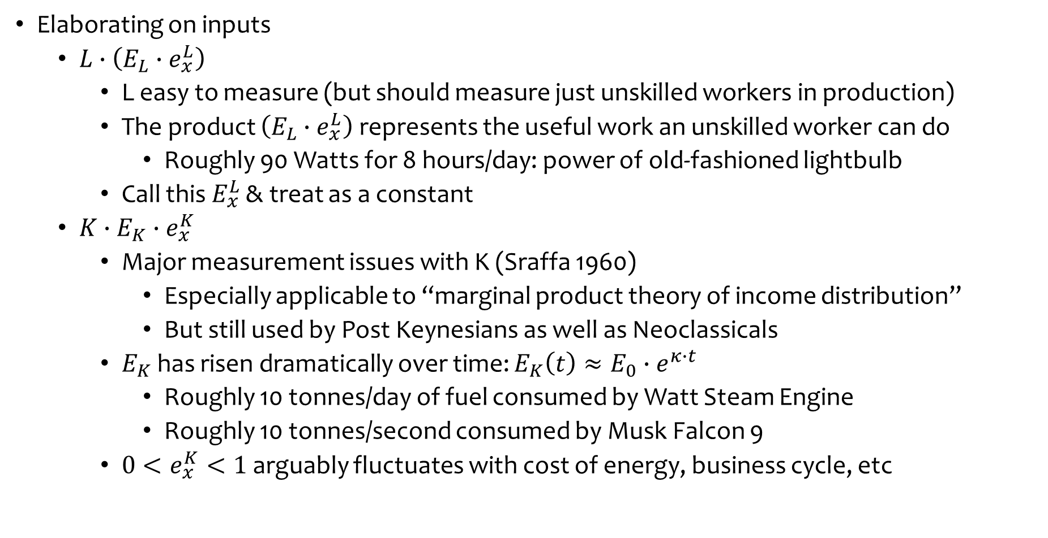
Incorporating Energy into models of production
Elaborating on inputs
  $L∙\left(E_{L}∙e_{x}^{L}\right)$
    L easy to measure (but should measure just unskilled workers in production)
    The product $\left(E_{L}∙e_{x}^{L}\right)$ represents the useful work an unskilled worker can do
      Roughly 90 Watts for 8 hours/day: power of old-fashioned lightbulb
    Call this $E_{x}^{L}$ & treat as a constant
  $K∙E_{K}∙e_{x}^{K}$
    Major measurement issues with K (Sraffa 1960)
      Especially applicable to “marginal product theory of income distribution”
      But still used by Post Keynesians as well as Neoclassicals
    $E_{K}$ has risen dramatically over time: $E_{K}\left(t\right)≈E_{0}∙e^{κ∙t}$
      Roughly 10 tonnes/day of fuel consumed by Watt Steam Engine
      Roughly 10 tonnes/second consumed by Musk Falcon 9
    ${0<e}_{x}^{K}<1$ arguably fluctuates with cost of energy, business cycle, etc

Slide 9
Incorporating Energy into models of production
Feed this into Neoclassical Cobb-Douglas Production Function (minus A term):
Equivalent to A term in energy-deficient CDPF
Constant, call this Λ
Original CDPF arguments
Final equation:
Numerous improvements over standard Cobb-Douglas Production Function
  Energy now vital: exponent can’t be set to zero without doing the same to K
Explains the “Solow Residual”: it’s the contribution to the increase in aggregate output of the increase in the useful-work capacity of the representative machine
Crucially for Green Finance, equation is compatible with the Laws of Thermodynamics

Slide 10
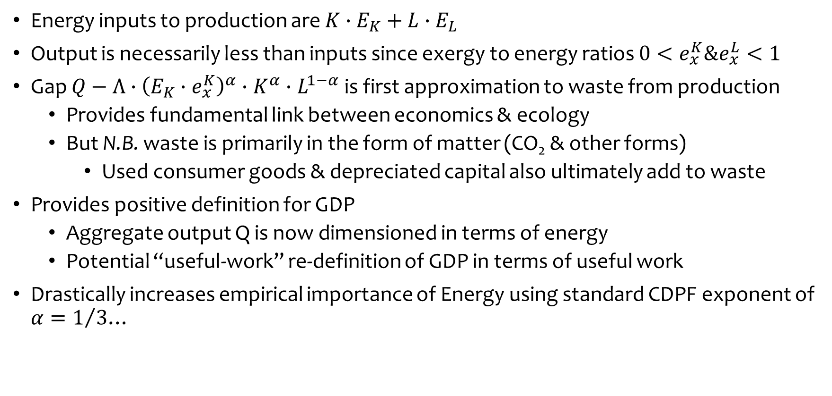
Incorporating Energy into models of production
Energy inputs to production are $K∙E_{K}+L∙E_{L}$
Output is necessarily less than inputs since exergy to energy ratios ${0<e}_{x}^{K}\&e_{x}^{L}<1$
Gap $Q−Λ∙{\left(E_{K}∙e_{x}^{K}\right)}^{α}∙K^{α}∙L^{1−α}$ is first approximation to waste from production
  Provides fundamental link between economics & ecology
  But N.B. waste is primarily in the form of matter (CO₂ & other forms)
    Used consumer goods & depreciated capital also ultimately add to waste
Provides positive definition for GDP
  Aggregate output Q is now dimensioned in terms of energy
  Potential “useful-work” re-definition of GDP in terms of useful work
Drastically increases empirical importance of Energy using standard CDPF exponent of $α=1/3$…

Slide 11
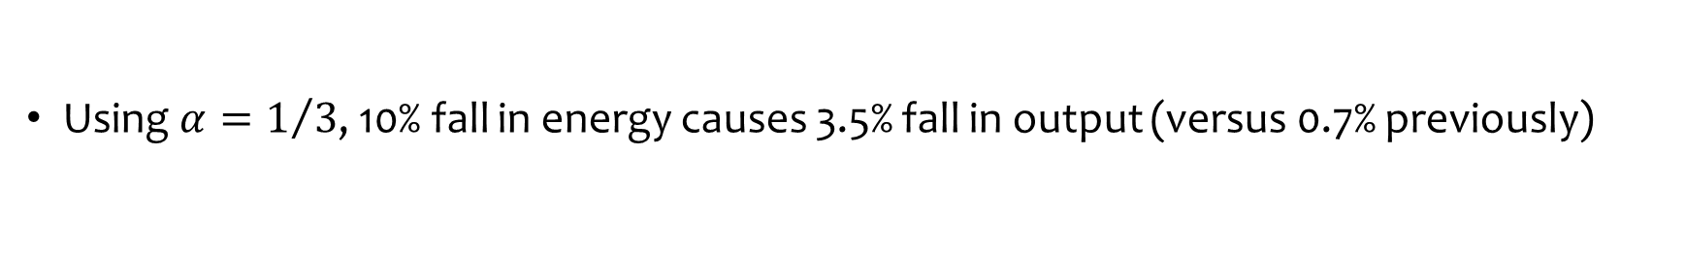

Incorporating Energy into models of production
Using $α=1/3$, 10% fall in energy causes 3.5% fall in output (versus 0.7% previously)
But arguably $α$ should be much higher: of the order of $2/3$:
See Mankiw, N. G., in E. S. Phelps, et al., (eds) (1995), “The Growth of Nations”, Brookings Papers on Economic Activity 1995: 1, pp. 275-326…

Slide 12
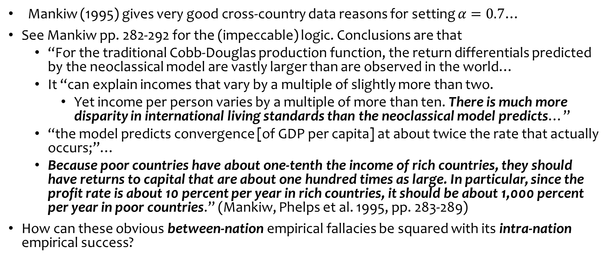
Incorporating Energy into models of production
Mankiw (1995) gives very good cross-country data reasons for setting $α=0.7$…
See Mankiw pp. 282-292 for the (impeccable) logic. Conclusions are that
  “For the traditional Cobb-Douglas production function, the return differentials predicted by the neoclassical model are vastly larger than are observed in the world…
  It “can explain incomes that vary by a multiple of slightly more than two.
    Yet income per person varies by a multiple of more than ten. There is much more disparity in international living standards than the neoclassical model predicts…”
  “the model predicts convergence [of GDP per capita] at about twice the rate that actually occurs;”…
  Because poor countries have about one-tenth the income of rich countries, they should have returns to capital that are about one hundred times as large. In particular, since the profit rate is about 10 percent per year in rich countries, it should be about 1,000 percent per year in poor countries.” (Mankiw, Phelps et al. 1995, pp. 283-289)
How can these obvious between-nation empirical fallacies be squared with its intra-nation empirical success?

Slide 13
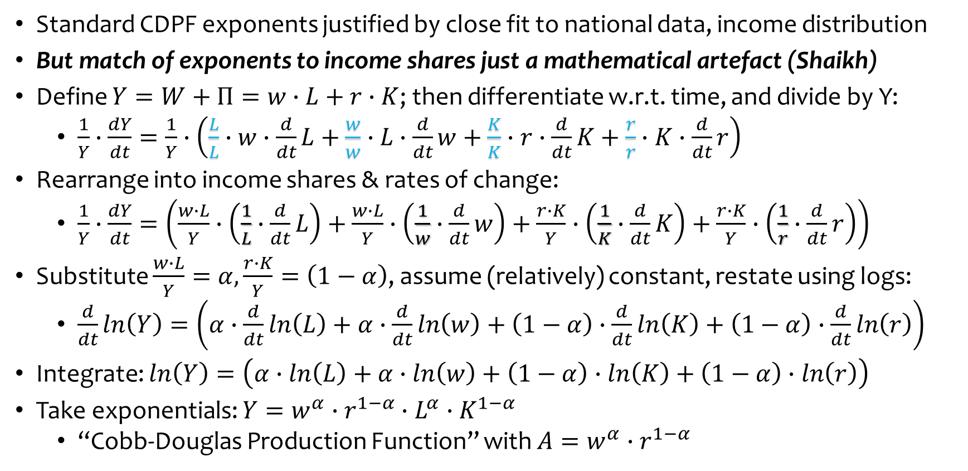
Incorporating Energy into models of production
Standard CDPF exponents justified by close fit to national data, income distribution
But match of exponents to income shares just a mathematical artefact (Shaikh)
Define $Y=W+Π=w∙L+r∙K$; then differentiate w.r.t. time, and divide by Y:
  $\frac{1}{Y}∙\frac{dY}{dt}=\frac{1}{Y}∙\left(\frac{L}{L}∙w∙\frac{d}{dt}L+\frac{w}{w}∙L∙\frac{d}{dt}w+\frac{K}{K}∙r∙\frac{d}{dt}K+\frac{r}{r}∙K∙\frac{d}{dt}r\right)$
Rearrange into income shares & rates of change:
  $\frac{1}{Y}∙\frac{dY}{dt}=\left(\frac{w∙L}{Y}∙\left(\frac{1}{L}∙\frac{d}{dt}L\right)+\frac{w∙L}{Y}∙\left(\frac{1}{w}∙\frac{d}{dt}w\right)+\frac{r∙K}{Y}∙\left(\frac{1}{K}∙\frac{d}{dt}K\right)+\frac{r∙K}{Y}∙\left(\frac{1}{r}∙\frac{d}{dt}r\right)\right)$
Substitute $\frac{w∙L}{Y}=α,\frac{r∙K}{Y}=\left(1−α\right)$, assume (relatively) constant, restate using logs:
  $\frac{d}{dt}ln\left(Y\right)=\left(α∙\frac{d}{dt}ln\left(L\right)+α∙\frac{d}{dt}ln\left(w\right)+\left(1−α\right)∙\frac{d}{dt}ln\left(K\right)+\left(1−α\right)∙\frac{d}{dt}ln\left(r\right)\right)$
Integrate: $ln\left(Y\right)=\left(α∙ln\left(L\right)+α∙ln\left(w\right)+\left(1−α\right)∙ln\left(K\right)+\left(1−α\right)∙ln\left(r\right)\right)$
Take exponentials: $Y=w^{α}∙r^{1−α}∙L^{α}∙K^{1−α}$
  “Cobb-Douglas Production Function” with $A=w^{α}∙r^{1−α}$

Slide 14
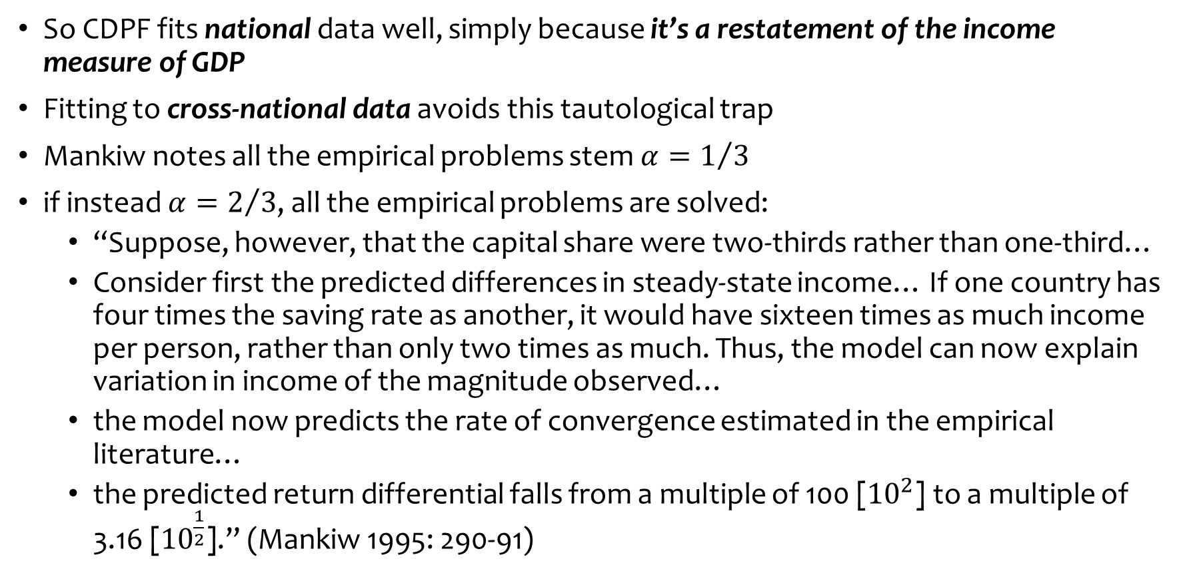
Incorporating Energy into models of production
So CDPF fits national data well, simply because it’s a restatement of the income measure of GDP
Fitting to cross-national data avoids this tautological trap
Mankiw notes all the empirical problems stem $α=1/3$
if instead $α=2/3$, all the empirical problems are solved:
  “Suppose, however, that the capital share were two-thirds rather than one-third…
  Consider first the predicted differences in steady-state income… If one country has four times the saving rate as another, it would have sixteen times as much income per person, rather than only two times as much. Thus, the model can now explain variation in income of the magnitude observed…
  the model now predicts the rate of convergence estimated in the empirical literature…
  the predicted return differential falls from a multiple of 100 [${10}^{2}$] to a multiple of 3.16 [${10}^{\frac{1}{2}}$].” (Mankiw 1995: 290-91)

Slide 15

Incorporating Energy into models of production
Mankiw proposes externalities & human capital reasons for setting $α=2/3$
Much better reason: higher exponent reflects vital role of energy in production
Much more realistic representation of crucial role of energy in production…
Energy (for machines) & machines both far more important than Labour for increasing output
10% fall in energy input now generates 6.8% fall in output
Much more work needed on this new approach…

Slide 16
Incorporating Energy into models of production
Advances over current practice
  Compatible with the Laws of Thermodynamics (no more “deepest humiliation”)
    GDP is useful work (measured in Joules/Year)
    Necessarily less than energy input to GDP
      There is no surplus (in keeping with 1st Law)
    There necessarily is waste: GDP is less than energy used to produce GDP
      In keeping with 2nd Law
      Links economics & ecology “at the hip”
        Carbon-based (& Nuclear) Energy mined from biosphere
          Biosphere (renewable & non-renewable) depleted by production
        Waste energy (mainly in material form) dumped into biosphere

Slide 17
Incorporating Energy into models of production
Work needed:
  Redefinition of GDP as useful work
    Redefine in terms of fundamental human needs (food, shelter, transport…)
    Objective measures (movement: mass from x to y in given time)
      Traffic accidents deduct from GDP, rather than increasing it as now
  Redo Cambridge Controversy debate with energy as essential non-commodity input
    Potential resolution of heterogeneity of capital problems in aggregation
      All machines help convert homogenous energy into useful work
  Build properly-linked economic-ecological models
    Limits to Growth with correct model of the production-waste nexus
  History of economic thought
    How did economics, both mainstream and heterodox, come to ignore or mischaracterize the role of energy in production for so long?

Slide 18
Incorporating Energy into models of production
Comments & Questions before next section?

Slide 19
The Role of Banks, Debt & Credit in Macroeconomics
Central Banks reject Loanable Funds/Money Multiplier models of banking:
Loanable Funds false:
  Bank of England 2014: “Rather than banks receiving deposits when households save and then lending them out, bank lending creates deposits.”
  Bundesbank 2017: “It suffices to look at the creation of (book) money as a set of straightforward accounting entries to grasp that money and credit are created as the result of complex interactions between banks, non- banks and the central bank.
  “this refutes a popular misconception that banks act simply as intermediaries at the time of lending – i.e. that banks can only grant credit using funds placed with them previously as deposits by other customers.”
Money multiplier model false:
  Bank of England 2014: “In normal times, the central bank does not fix the amount of money in circulation, nor is central bank money ‘multiplied up’ into more loans and deposits.”
  Bundesbank 2017: “And a bank’s ability to grant loans and create money has nothing to do with whether it already has excess reserves or deposits at its disposal.”

Slide 20
The Role of Banks, Debt & Credit in Macroeconomics
Technical issue clear: banks do not intermediate, but originate money & debt
But what are the macroeconomic implications? Conflicting views:
  OLG models: no significant implications (Faure and Gersbach 2017)
    “all the newly detected phenomena linked to money creation are connected to the presence of risks and bank default.
    In the absence of idiosyncratic and aggregate risks, the loanable-funds and the money-creation approaches are equivalent, since the allocations are identical.” (p. 2)
  DSGE models: significant implications (Kumhof and Jakab 2015)
    “Compared to otherwise identical intermediation models, and following identical shocks, financing models predict changes in bank lending that are far larger, happen much faster, and have much greater effects on the real economy.” (p. i)
Both views cannot be right. So which one is correct?

Slide 21
The Role of Banks, Debt & Credit in Macroeconomics
A logical analysis: derive relative impact from identity of Aggregate Demand & Supply
Divide economy into 3 sectors, where each sector spends on the other two
3x3 “Moore Table”: diagonal is expenditure (-), off-diagonal is income (+)
Each row must sum to zero: (Your) Expenditure IS (Someone Else’s) Income
Column sum can be non-zero: sectoral incomes can differ from expenditures
3 monetary arrangements
  “Say’s Law”: no lending possible
  “Loanable Funds”: lending between two sectors (along diagonal)
  “Bank Originated Money & Debt”: Bank (4th sector) lends to one sector
    Its Assets (not shown in Table) rise in tandem with new net lending

Slide 22
The Role of Banks, Debt & Credit in Macroeconomics
Firstly, “Say’s Law”: Expenditure only from existing money, no lending/borrowing
Expenditure by sector 1
Income generated by sector 1’s expenditure
Income for sector 1
Effectively Friedman’s “Quantity theory of money”
  Aggregate Demand ≡ Aggregate Income = money times velocity of circulation

Slide 23
The Role of Banks, Debt & Credit in Macroeconomics
“Loanable Funds”
  Sector 2 lends to sector 1 (flow across trace)
  Sector 1 pays interest to sector 2
  Sector 1 spends on sector 3
Expenditure of credit
Flow of credit
Credit cancels out
  IF loanable funds were true, THEN banking could be ignored in macroeconomics

Slide 24
The Role of Banks, Debt & Credit in Macroeconomics
“Bank Originated Money and Debt”: Bank lending (to sector 1) creates money
Sector 1 spends this money on sector 3
Credit (increase in Bank Liabilities) created by increase in debt (Bank assets—not shown)
Credit does not cancel out
  SINCE BOMD is true, THEN banking cannot be ignored in macroeconomics
  Credit is the most volatile component of aggregate demand and income

Slide 25
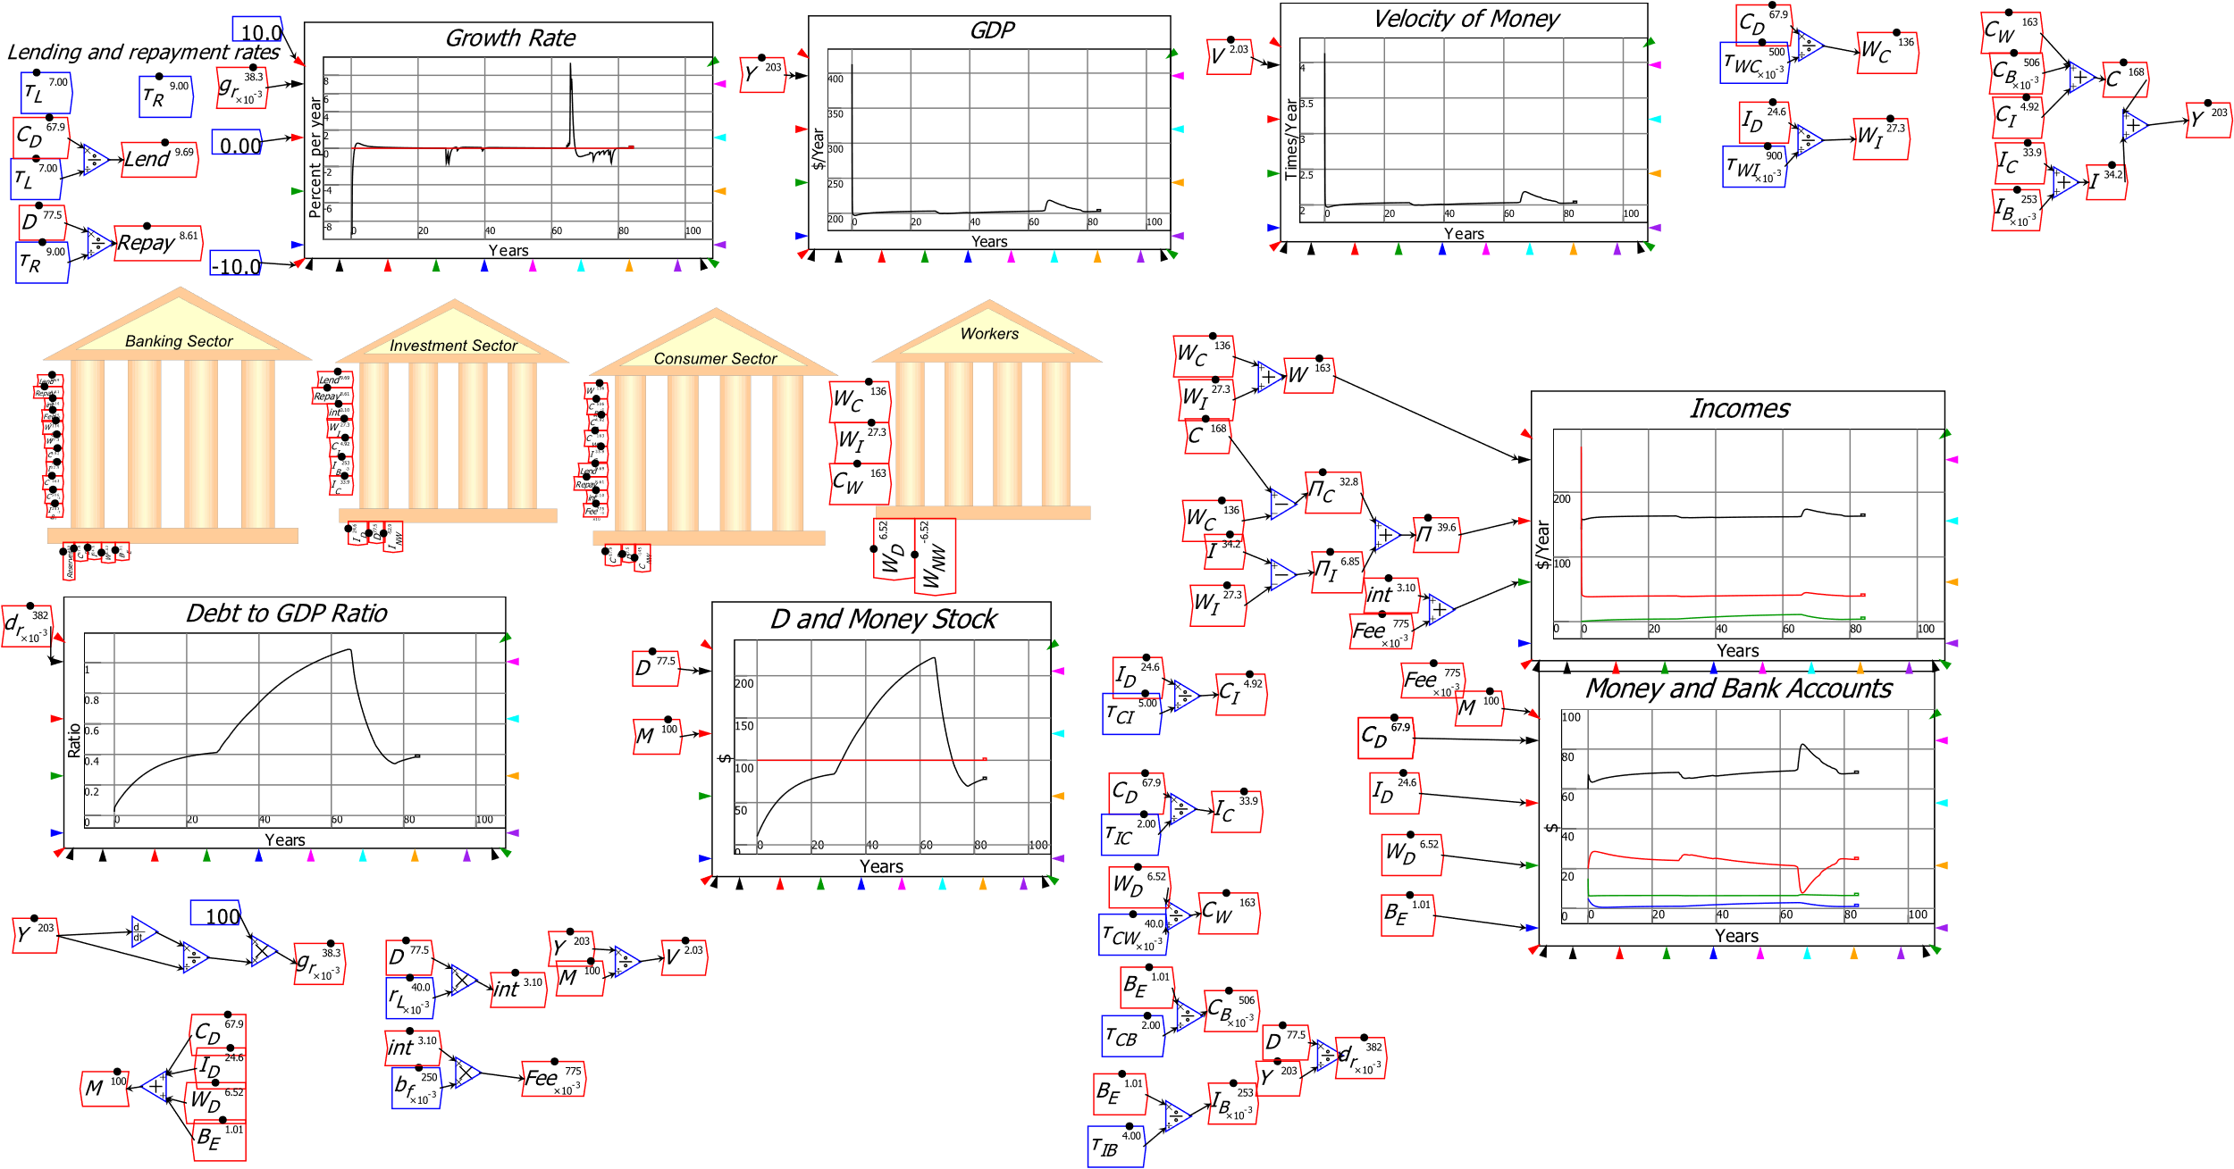
Modelling LF vs BOMD in Minsky
Illustrating this this in Minsky: system dynamics software supporting monetary modelling using double-entry bookkeeping…
Krugman & Eggertsson (2012 supplement) had Loanable Funds model
  “Patient” Consumer goods producing agent lends to “Impatient” Investment goods producing agent
  Bank charges “Intermediation Fee”
Huge changes in credit and debt
Trivial changes in DP

Slide 26
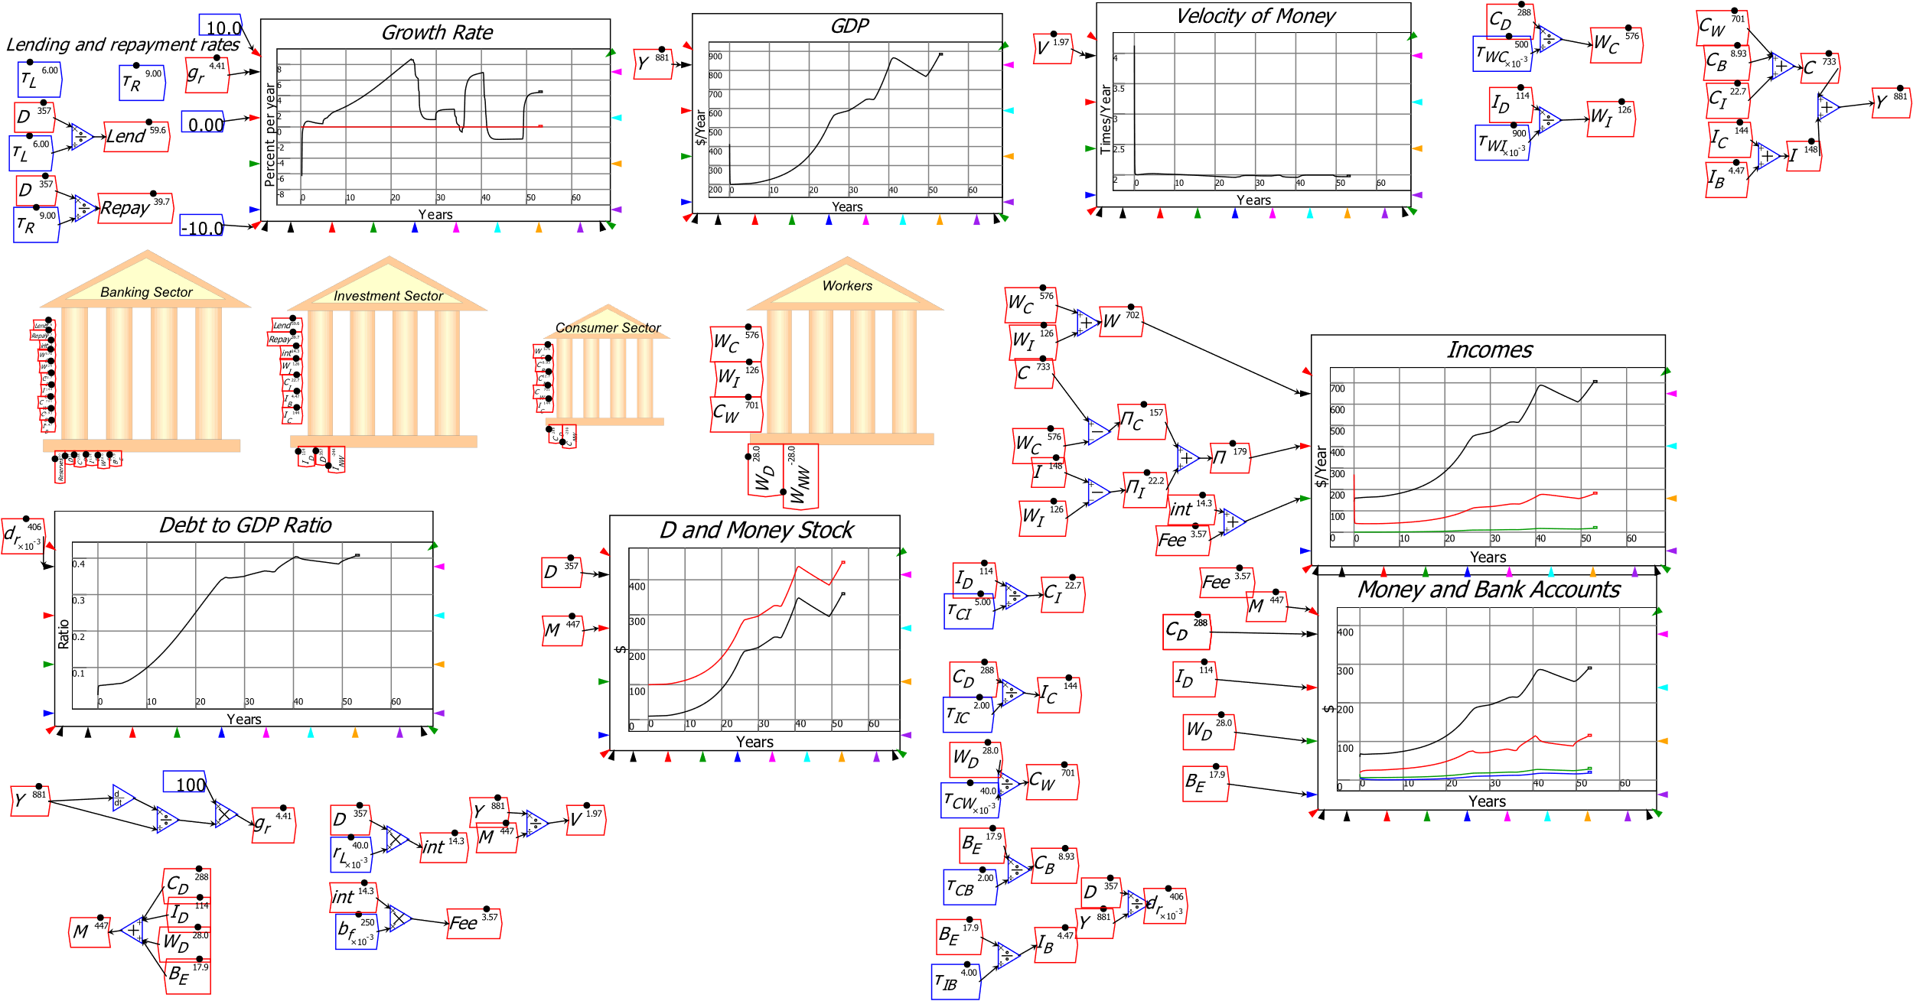
Modelling LF vs BOMD in Minsky
Easily modify it to BOMD…
Huge changes in credit and debt
Huge changes in GDP

Slide 27
Statistics support significance of Credit in GDP/Asset Pricing
Following Loanable Funds, leading Central Bank figures ignored credit
  “The idea of debt-deflation … was less influential in academic circles, though, because of the counterargument that debt-deflation represented no more than a redistribution from one group (debtors) to another (creditors).
  Absent implausibly large differences in marginal spending propensities among the groups, it was suggested, pure redistributions should have no significant macro-economic effects.” (Bernanke, 2000, p. 24)
Bank lending is not “pure redistribution” but creation of money and spending power
  Well understood by Fisher: “A man-to-man debt may be paid without affecting the volume of outstanding currency j for whatever currency is paid by one, whether it be legal tender or deposit currency transferred by check, is received by the other, and is still outstanding.
  But when a debt to a commercial bank is paid by check out of a deposit balance, that amount of deposit currency simply disappears.” (Fisher 1932, Booms and Depressions, p. 15)

Slide 28
Statistics support significance of Credit in GDP/Asset Pricing
As most volatile component of aggregate demand, credit dominates macroeconomics

Slide 29
Statistics support significance of Credit in GDP/Asset Pricing
Correlation of credit with unemployment in the USA since 1990 is minus 0.85
Causation runs from credit to aggregate demand (as shown in Moore Table)
Similar results for all other countries in BIS database
  (Except Germany!
    Huge trade surplus plus government austerity
    Low/falling credit usage)

Slide 30
Statistics support significance of Credit in GDP/Asset Pricing
Correlation of change in household credit with real house price change is 0.71
Granger causality test confirms causation from change in household credit (acceleration of household debt) to change in inflation-adjusted house price index

Slide 31
The Quest for Foundations for Macroeconomics
Old AS-AD, IS-LM, large scale macroeconomic models rejected as “ad hoc”
Microfoundations approach developed by Kydland-Prescott-Lucas-Sargent-Rapping-Muth-Woodford etc. to properly ground macroeconomics
But models wrongly excluded credit, debt, banking, as shown
Completely failed to anticipate 2008 financial crisis as a result
Can DSGE models with credit, debt & banking warn of future crises?
  Perhaps: see Kumhof’s work
  But not as “financial frictions”
    Frictions slow down a return to equilibrium
    Can’t explain finance causing divergence from equilibrium during boom times
    Also very complicated to build & extend (from conversations with Kumhof)
An alternative approach may be much better founded and simpler…

Slide 32

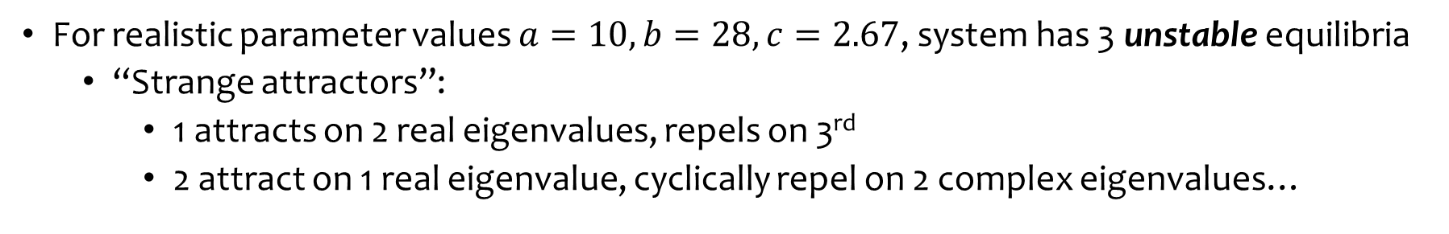
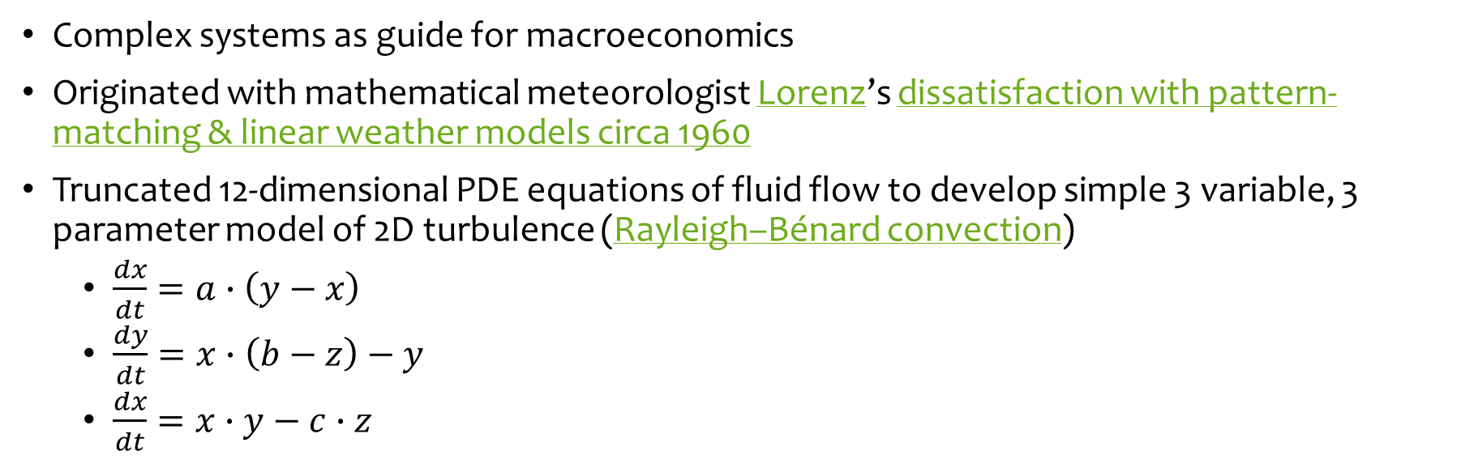
The Quest for Foundations for Macroeconomics
Complex systems as guide for macroeconomics
Originated with mathematical meteorologist Lorenz’s dissatisfaction with pattern-matching & linear weather models circa 1960
Truncated 12-dimensional PDE equations of fluid flow to develop simple 3 variable, 3 parameter model of 2D turbulence (Rayleigh–Bénard convection)
  $\frac{dx}{dt}=a∙\left(y−x\right)$
  $\frac{dy}{dt}=x∙\left(b−z\right)−y$
  $\frac{dx}{dt}=x∙y−c∙z$
For realistic parameter values $a=10,b=28,c=2.67$, system has 3 unstable equilibria
  “Strange attractors”:
    1 attracts on 2 real eigenvalues, repels on 3rd
    2 attract on 1 real eigenvalue, cyclically repel on 2 complex eigenvalues…

Slide 33
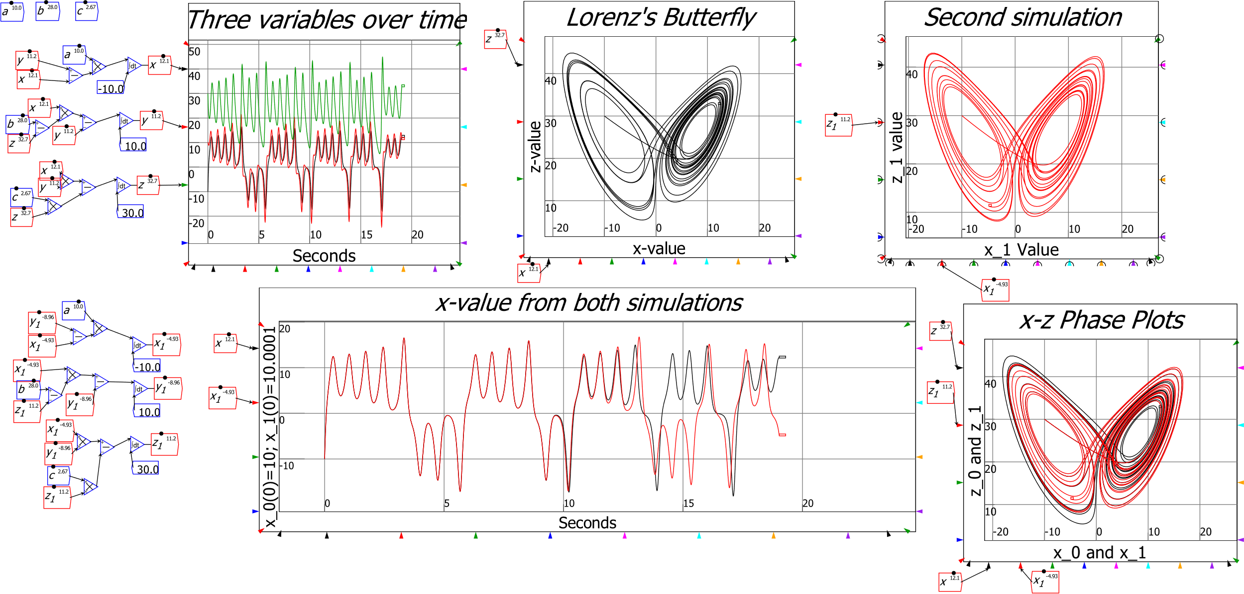
The Quest for Foundations for Macroeconomics
Result is cyclical aperiodic motion: “Deterministic Aperiodic Flow”

Slide 34
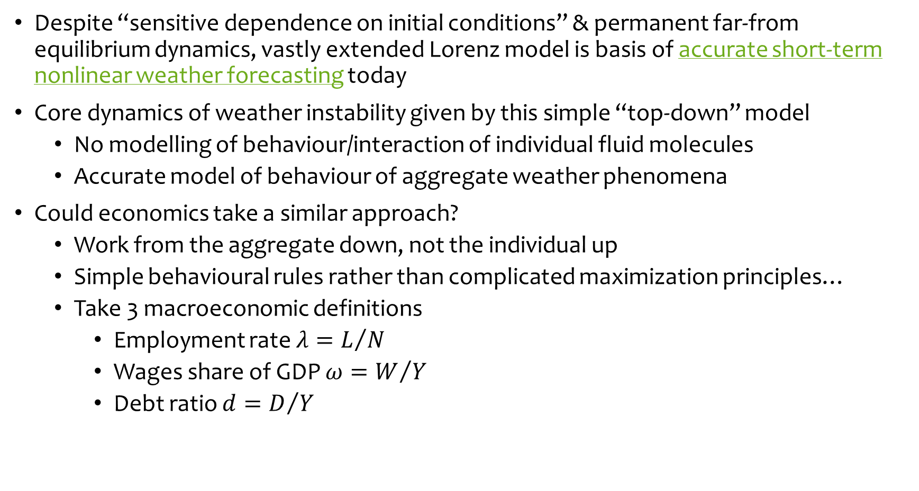
The Quest for Foundations for Macroeconomics
Despite “sensitive dependence on initial conditions” & permanent far-from equilibrium dynamics, vastly extended Lorenz model is basis of accurate short-term nonlinear weather forecasting today
Core dynamics of weather instability given by this simple “top-down” model
  No modelling of behaviour/interaction of individual fluid molecules
  Accurate model of behaviour of aggregate weather phenomena
Could economics take a similar approach?
  Work from the aggregate down, not the individual up
  Simple behavioural rules rather than complicated maximization principles…
  Take 3 macroeconomic definitions
    Employment rate $λ=L/N$
    Wages share of GDP $ω=W/Y$
    Debt ratio $d=D/Y$

Slide 35
A complex systems foundation for macroeconomics
Illustration of complex systems approach
Differentiate with respect to time to develop 3 dynamic definitions:
  The employment rate will rise if economic growth exceeds the sum of growth in labor productivity and population;
  The wages share of output will rise if wage demands exceed the growth in labor productivity; and
  The private debt to GDP ratio will rise if debt growth exceeds the rate of economic growth
Add simplest possible relationships between variables:
  Output Y_{R} a linear function of capital K_{R}
  Investment I_{R} a linear function of profit rate π_{r} (& depreciation)
  Employment a linear function of output
  Wage change a linear function of employment rate
  Change in debt equal to investment minus profits

Slide 36
A complex systems foundation for macroeconomics
Convert into a model with simplest possible relationships between variables
  Linear Capital: Output ratio, linear depreciation
Linear Phillips Curve
Linear Investment(Profit Rate) function
Debt finance when investment > profits
Constant growth in labour productivity & population

Slide 37
A complex systems foundation for macroeconomics
Simple system with 3 system states, 8 parameters & inherent nonlinearities
Comparable to Lorenz’s 3 equation model
  1 negative real eigenvalue, 2 complex eigenvalues
Real part of complex eigenvalues turns positive as π_{S}↑:

Slide 38
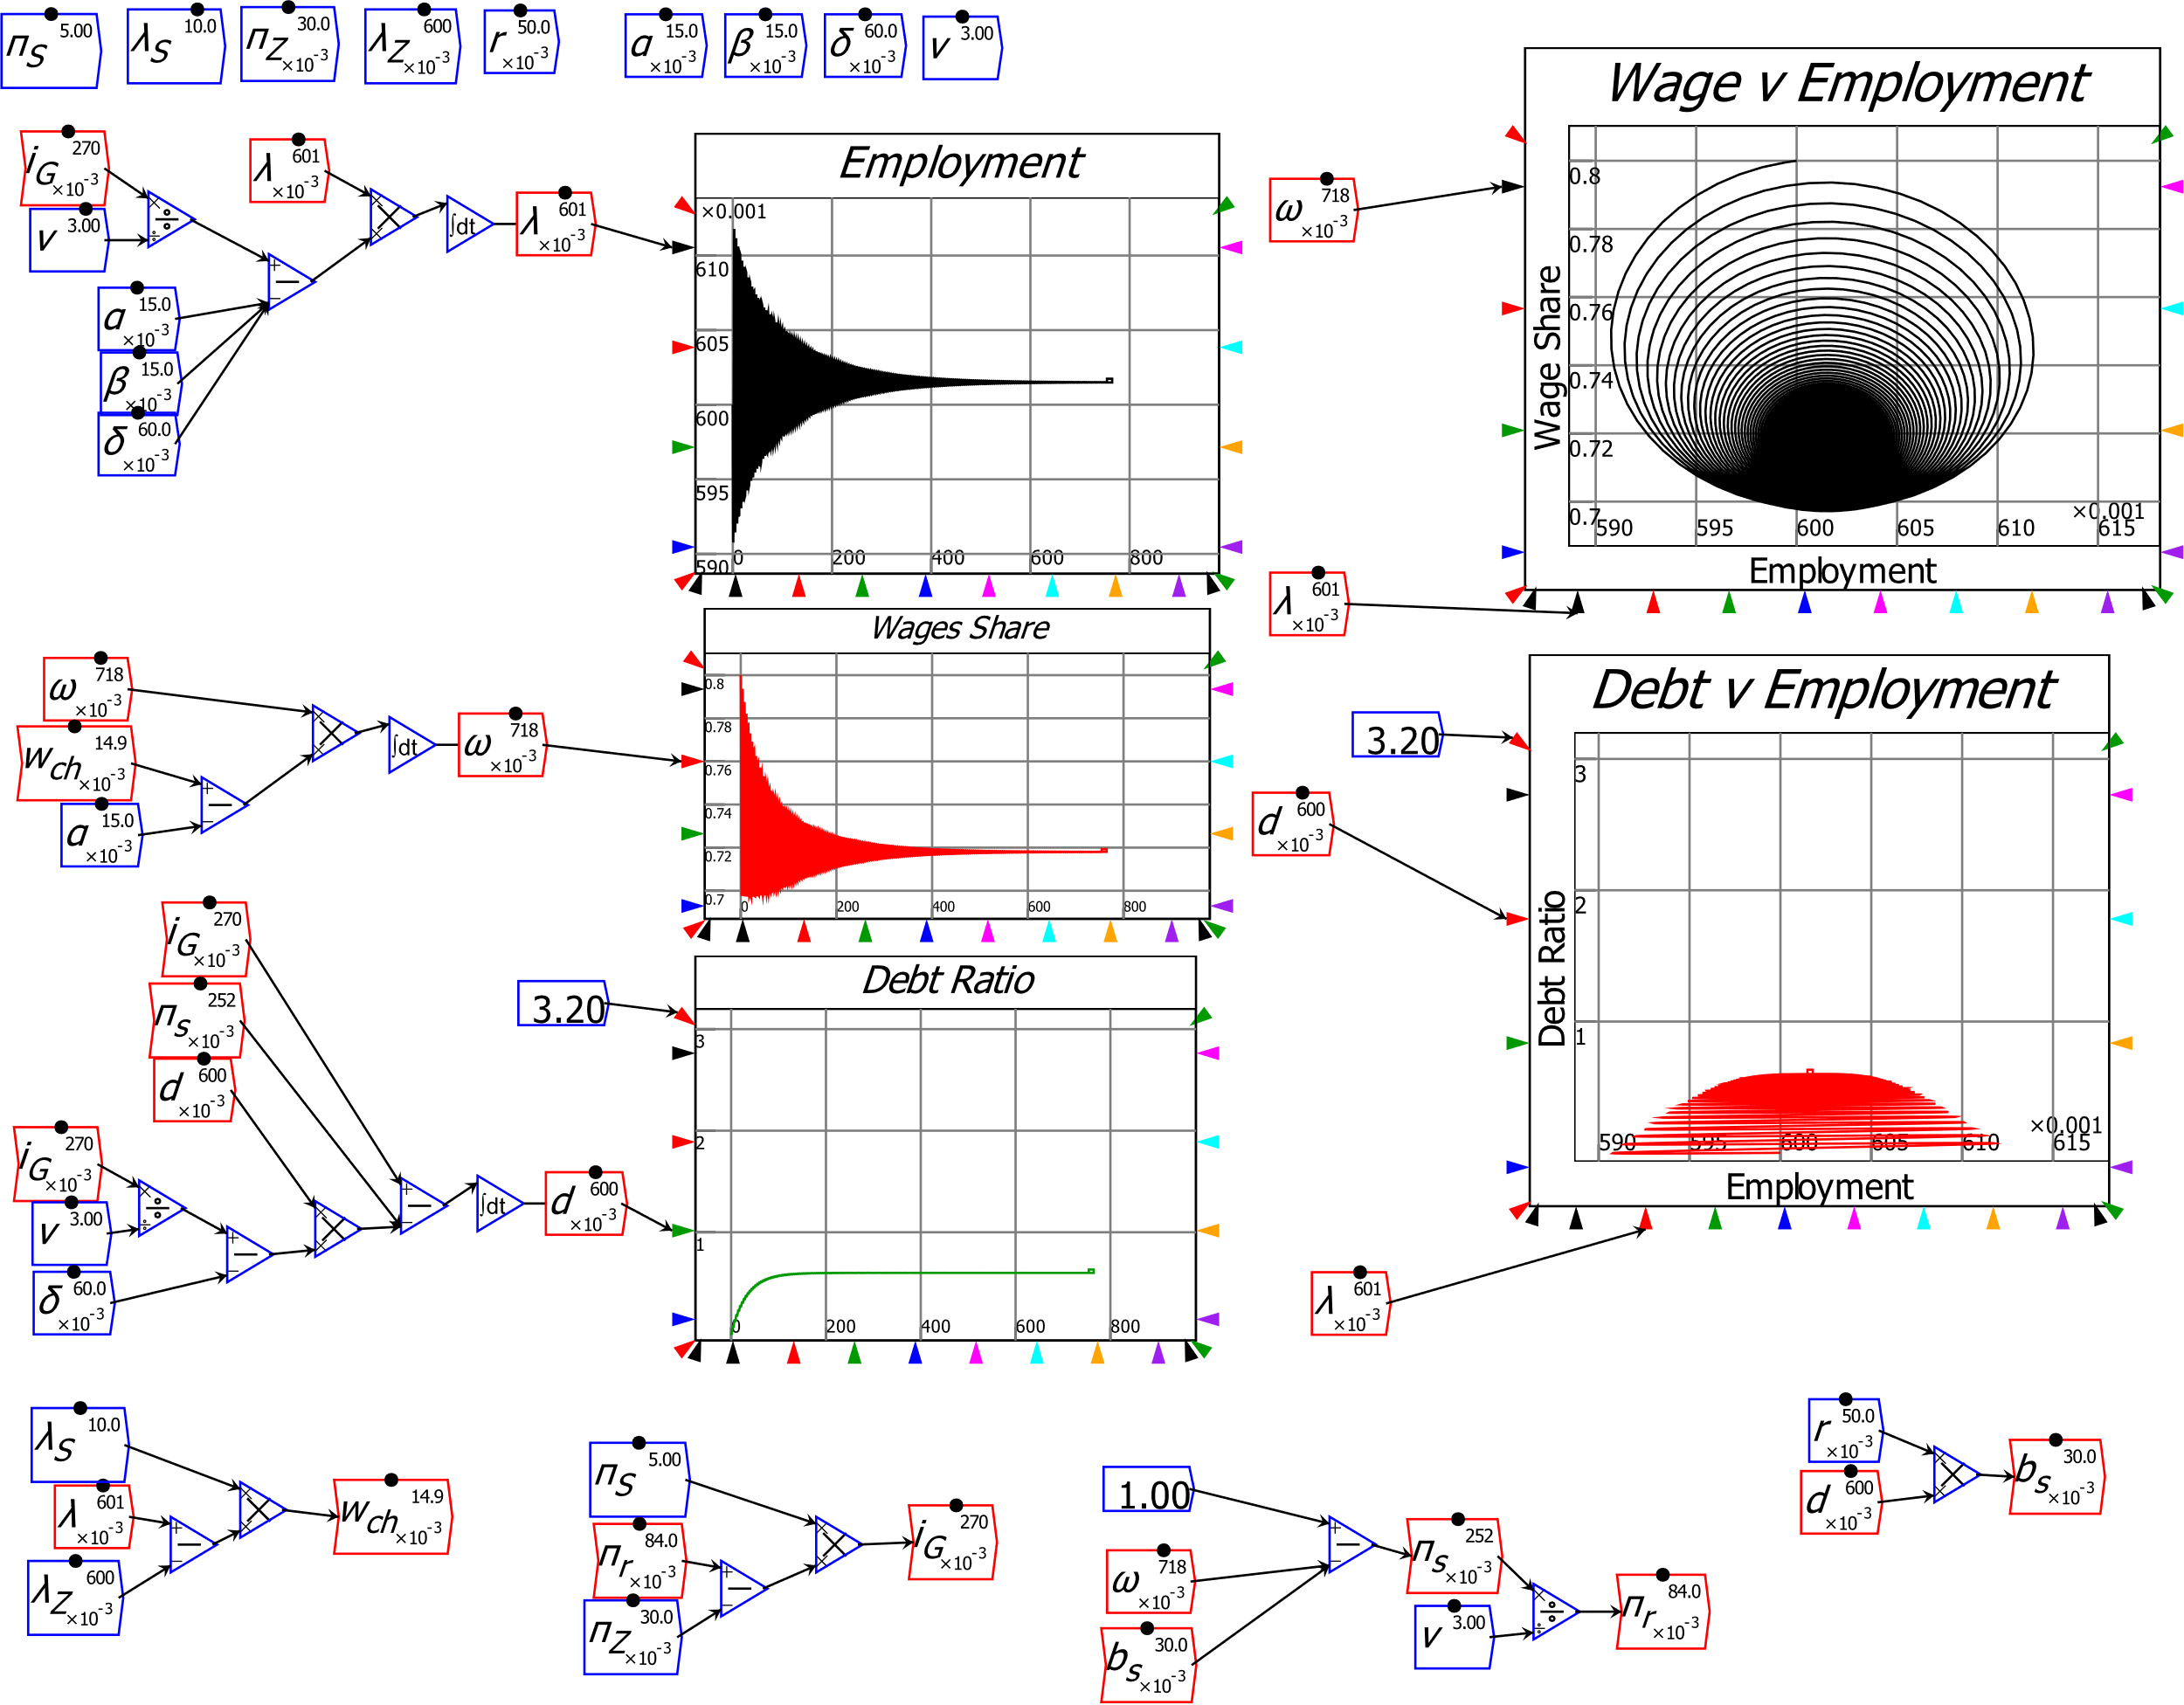
A complex systems foundation for macroeconomics
Resulting model has two meaningful (non-negative) equilibria
  “Good” equilibrium: positive employment rate, wages share, private debt ratio

Slide 39
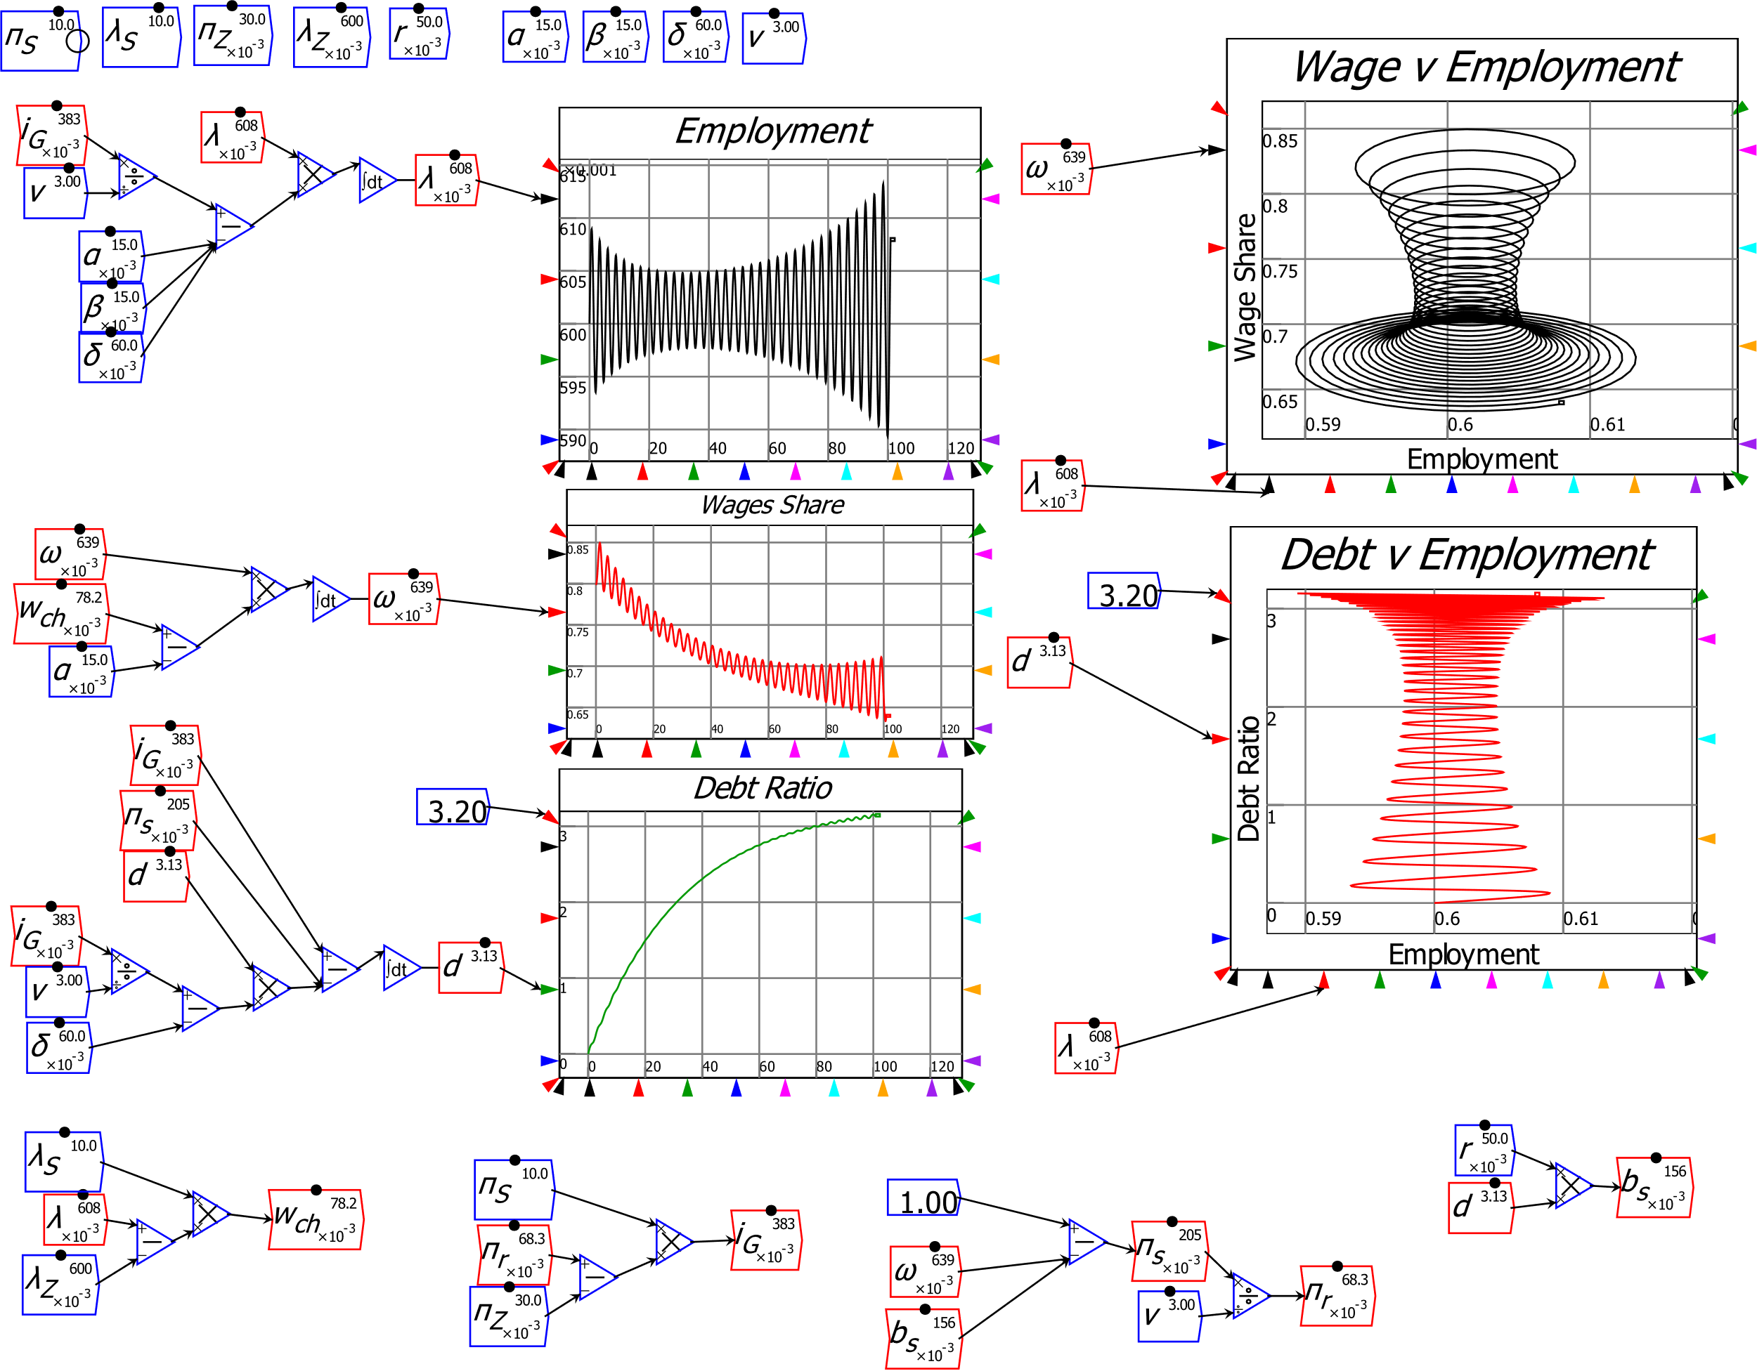
A complex systems foundation for macroeconomics
“Bad” equilibrium: zero employment rate, wages share, infinite debt ratio
High propensity to invest destabilizes the “good” equilibrium…
Highly stylized reproduction of “stylized facts” of last twenty years
Cyclically rising debt ratio
“Calm before the Storm”
“Great Moderation” followed by “Great Recession”
Pomeau-Manneville intermittent route to chaos
Rising inequality

Slide 40
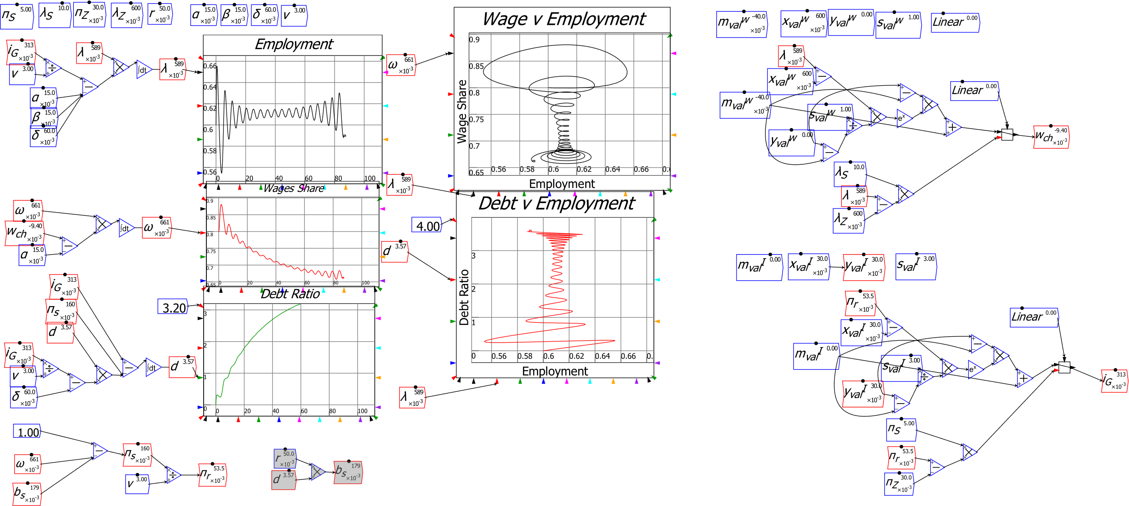
A complex systems foundation for macroeconomics
Nonlinear functions, government, variable capacity can all be added for more realism

Slide 41
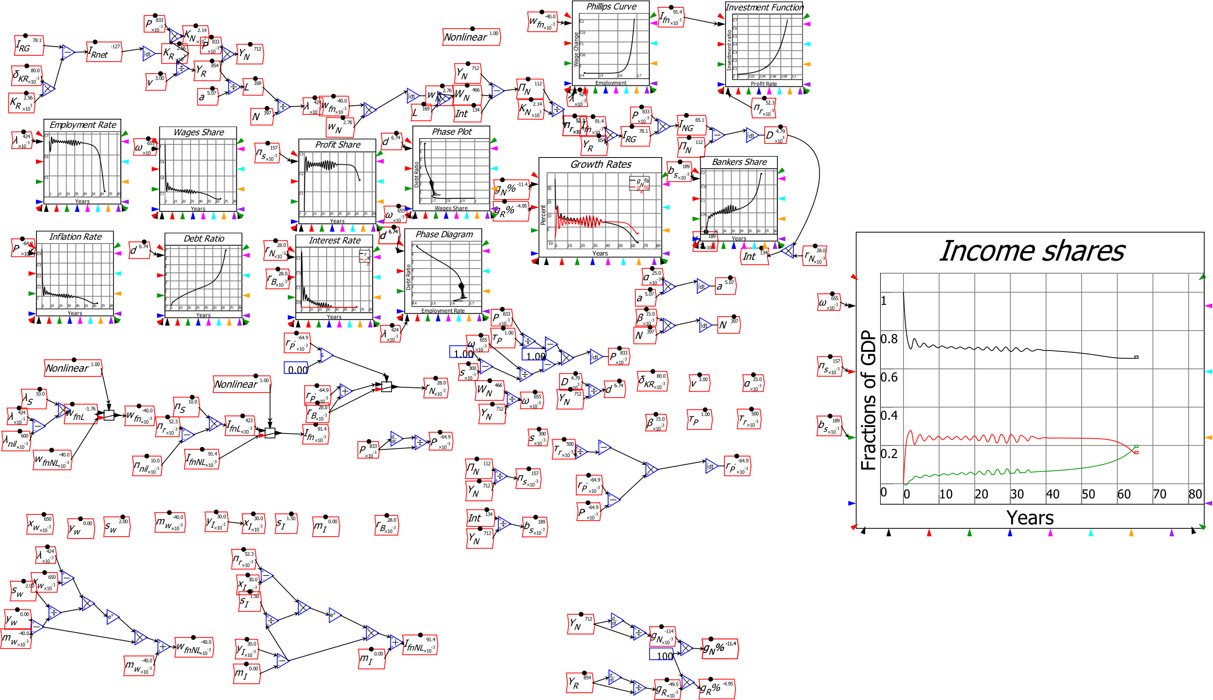
A complex systems foundation for macroeconomics
Model extended by extending definitions: prices, government, etc. Prices shown here
May learn more from carefully modelling structure of the economy than from modelling behaviour of agents in it…

Slide 42
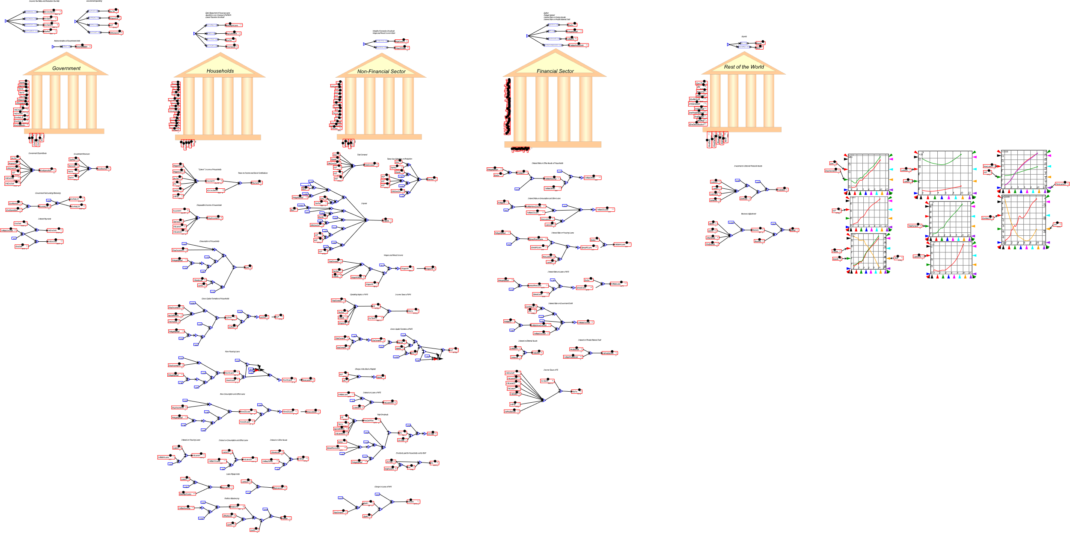
A monetary approach to macroeconomics
General Dynamics: far more elaborate models can be built & simulated:
5 sector model of Portuguese economy (Pratas, Portuguese Statistical Office)

Slide 43
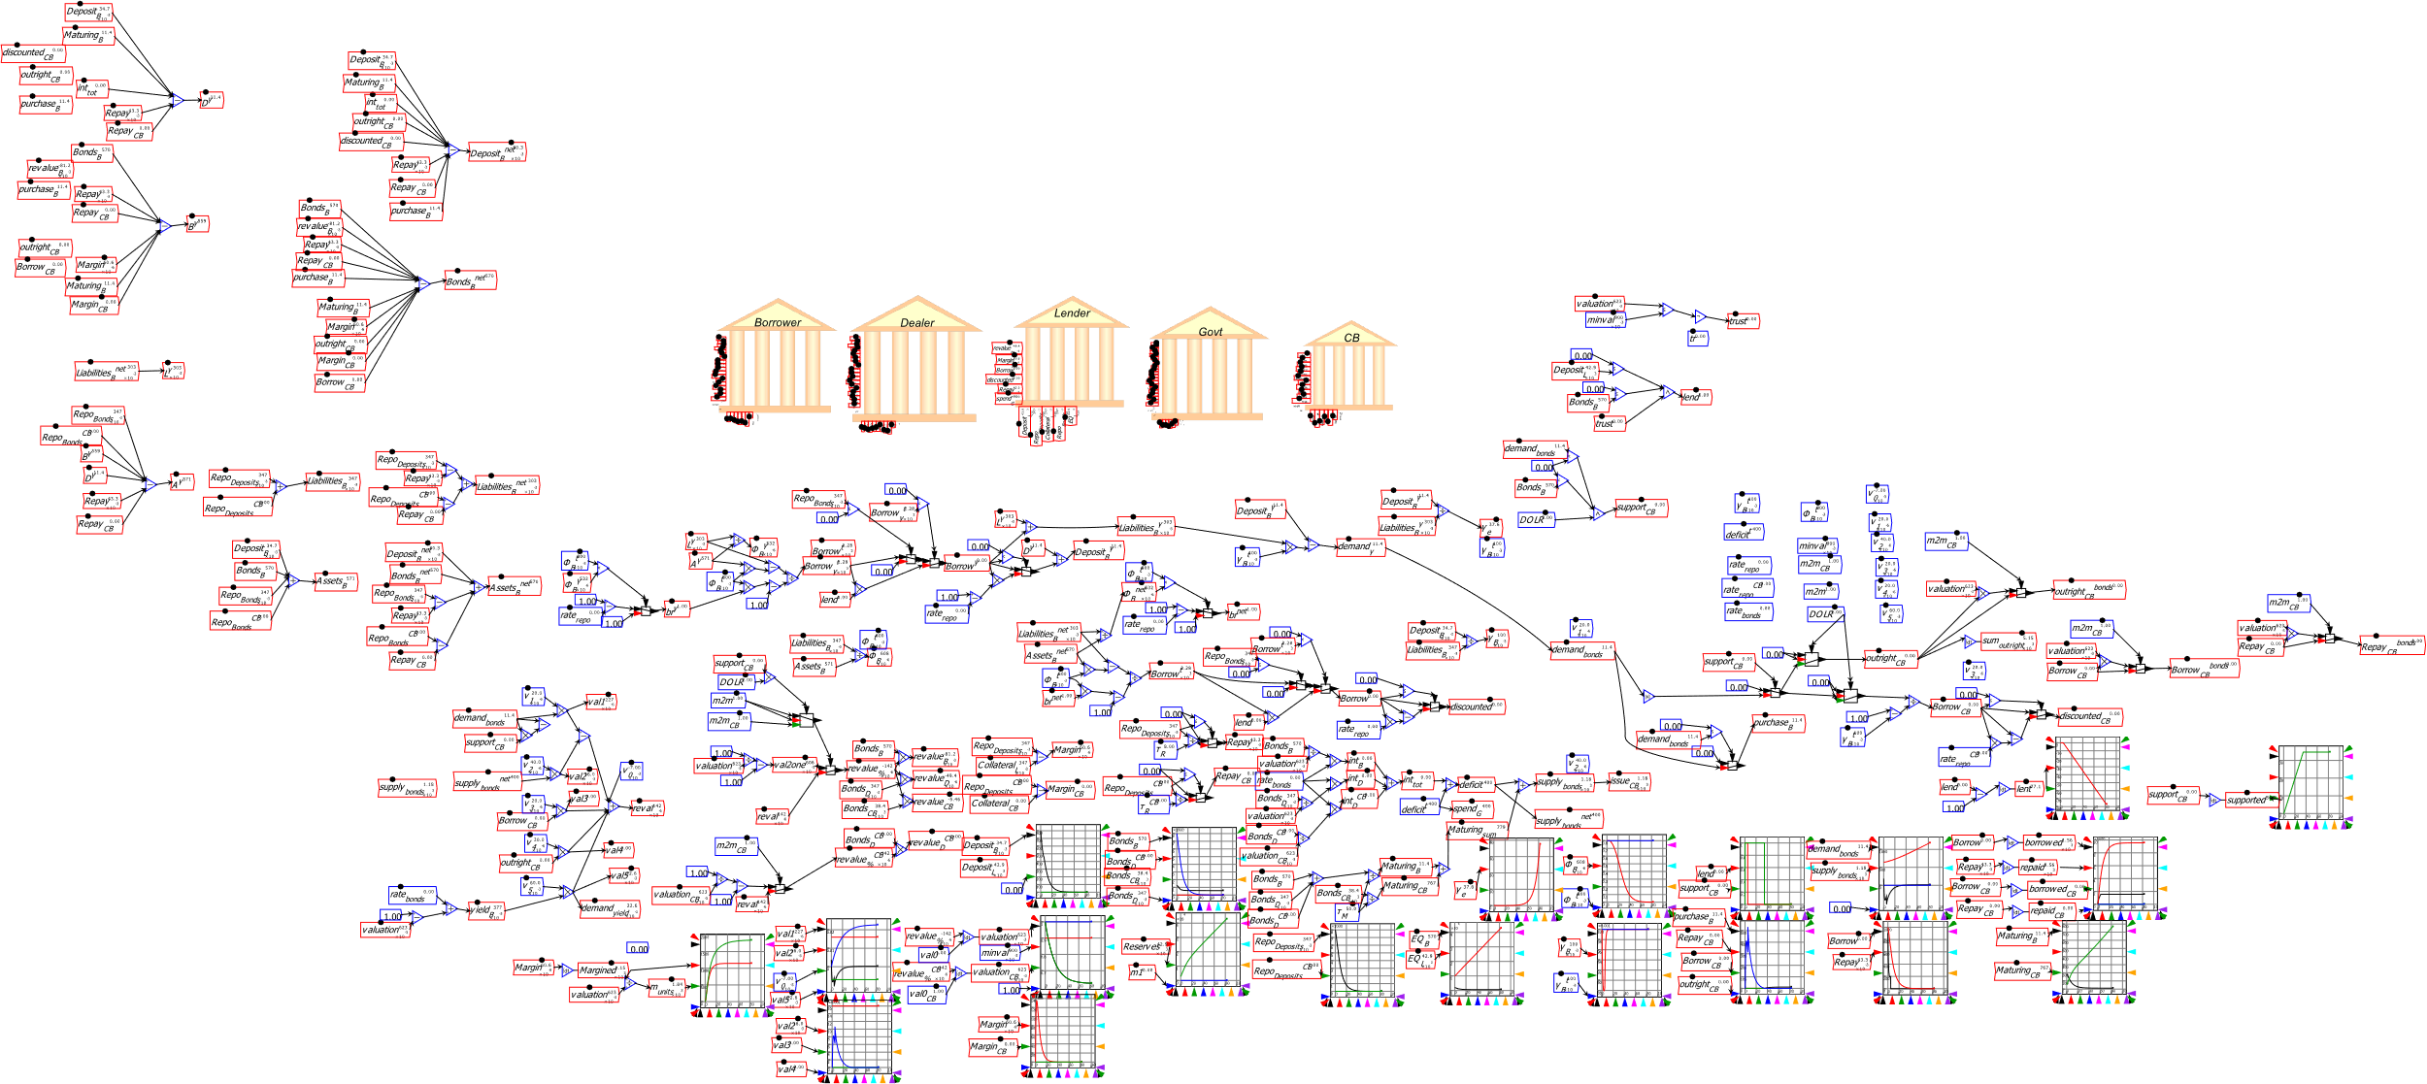
A monetary approach to macroeconomics
Stylized model of shadow banking (Jackson, Bank of England)

Slide 44

For more see https://www.patreon.com/ProfSteveKeen

