Slide 1
The misunderstood dynamics of private debt
www.patreon.com/profstevekeen
www.profstevekeen.com

Slide 2
Mainstream economics ignores private debt because…
Krugman 2012: “First of all, any individual bank does, in fact, have to lend out the money it receives in deposits. Bank loan officers can't just issue checks out of thin air; like employees of any financial intermediary, they must buy assets with funds they have on hand.
I hope this isn't controversial, although given what usually happens when we discuss banks, I assume that even this proposition will spur outrage.” (“Banking Mysticism, Continued”)
Bank of England 2014: “Rather than banks receiving deposits when households save and then lending them out, bank lending creates deposits.”
Bundesbank 2017: “look at the creation of (book) money as a set of straightforward accounting entries … money and credit are created as the result of complex interactions between banks, non- banks and the central bank.
  “this refutes a popular misconception that banks act simply as intermediaries at the time of lending – i.e. that banks can only grant credit using funds placed with them previously as deposits by other customers.”

Slide 3
Mainstream economics ignores private debt because…
Krugman 2013: “Maybe part of the problem is that Koo envisages an economy in which everyone is balance-sheet constrained, as opposed to one in which lots of people are balance-sheet constrained.
I’d say that his vision makes no sense: where there are debtors, there must also be creditors, so there have to be at least some people who can respond to lower real interest rates even in a balance-sheet recession.” (“Abenomics and Interest Rates: A Finger Exercise (Wonkish)”)
Fisher, 1932: “A man-to-man debt may be paid without affecting the volume of outstanding currency for whatever currency is paid by one, whether it be legal tender or deposit currency transferred by check, is received by the other, and is still outstanding.
But when a debt to a commercial bank is paid by check out of a deposit balance, that amount of deposit currency simply disappears.” (Booms and Depressions, p. 15)

Slide 4
Mainstream economics ignores private debt because…
Bernanke, 2000: “The idea of debt-deflation goes back to Irving Fisher (1933). Fisher envi­sioned a dynamic process in which falling asset and commodity prices cre­ated pressure on nominal debtors, forcing them into distress sales of assets, which in turn led to further price declines and financial difficulties.
His diagnosis led him to urge President Roosevelt to subordinate exchange-rate considerations to the need for reflation, advice that (ultimately) FDR fol­lowed.
Fisher's idea was less influential in academic circles, though, because of the counterargument that debt-deflation represented no more than a re­distribution from one group (debtors) to another (creditors). Absent implau­sibly large differences in marginal spending propensities among the groups, it was suggested, pure redistributions should have no significant macro­economic effects.” (Essays on the Great Depression, p. 24)

Slide 5
The Role of Banks, Debt & Credit in Macroeconomics
Technical issue clear: banks do not intermediate, but originate money & debt
But what are the macroeconomic implications? Conflicting mainstream views:
  OLG models: no significant implications (Faure and Gersbach 2017)
    “all the newly detected phenomena linked to money creation are connected to the presence of risks and bank default.
    In the absence of idiosyncratic and aggregate risks, the loanable-funds and the money-creation approaches are equivalent, since the allocations are identical.” (p. 2)
  DSGE models: significant implications (Kumhof and Jakab 2015)
    “Compared to otherwise identical intermediation models, and following identical shocks, financing models predict changes in bank lending that are far larger, happen much faster, and have much greater effects on the real economy.” (p. i)
Both views cannot be right. So which one is correct?

Slide 6
The Role of Banks, Debt & Credit in Macroeconomics
A logical analysis: derive relative impact from identity of Aggregate Demand & Supply
Divide economy into 3 sectors, where each sector spends on the other two
3x3 “Moore Table”: diagonal is expenditure (-), off-diagonal is income (+)
Each row must sum to zero: (Your) Expenditure IS (Someone Else’s) Income
Column sum can be non-zero: sectoral incomes can differ from expenditures
3 monetary arrangements
  “Say’s Law”: no lending possible
  “Loanable Funds”: lending between two sectors (along diagonal)
  “Bank Originated Money & Debt”: Bank (4th sector) lends to one sector
    Its Assets (not shown in Table) rise in tandem with new net lending

Slide 7
The Role of Banks, Debt & Credit in Macroeconomics
Firstly, “Say’s Law”: Expenditure only from existing money, no lending/borrowing
Expenditure by sector 1
Income generated by sector 1’s expenditure
Income for sector 1
Effectively Friedman’s “Quantity theory of money”
  Aggregate Demand ≡ Aggregate Income = money times velocity of circulation

Slide 8
The Role of Banks, Debt & Credit in Macroeconomics
“Loanable Funds”
  Sector 2 lends to sector 1 (flow across trace)
  Sector 1 pays interest to sector 2
  Sector 1 spends on sector 3
Expenditure of credit
Flow of credit
Credit cancels out
  IF loanable funds were true, THEN banking could be ignored in macroeconomics

Slide 9
The Role of Banks, Debt & Credit in Macroeconomics
“Bank Originated Money and Debt”: Bank lending (to sector 1) creates money
Sector 1 spends this money on sector 3
Credit (increase in Bank Liabilities) created by increase in debt (Bank assets—not shown)
Credit does not cancel out
  SINCE BOMD is true, THEN banking cannot be ignored in macroeconomics
  Credit is the most volatile component of aggregate demand and income

Slide 10
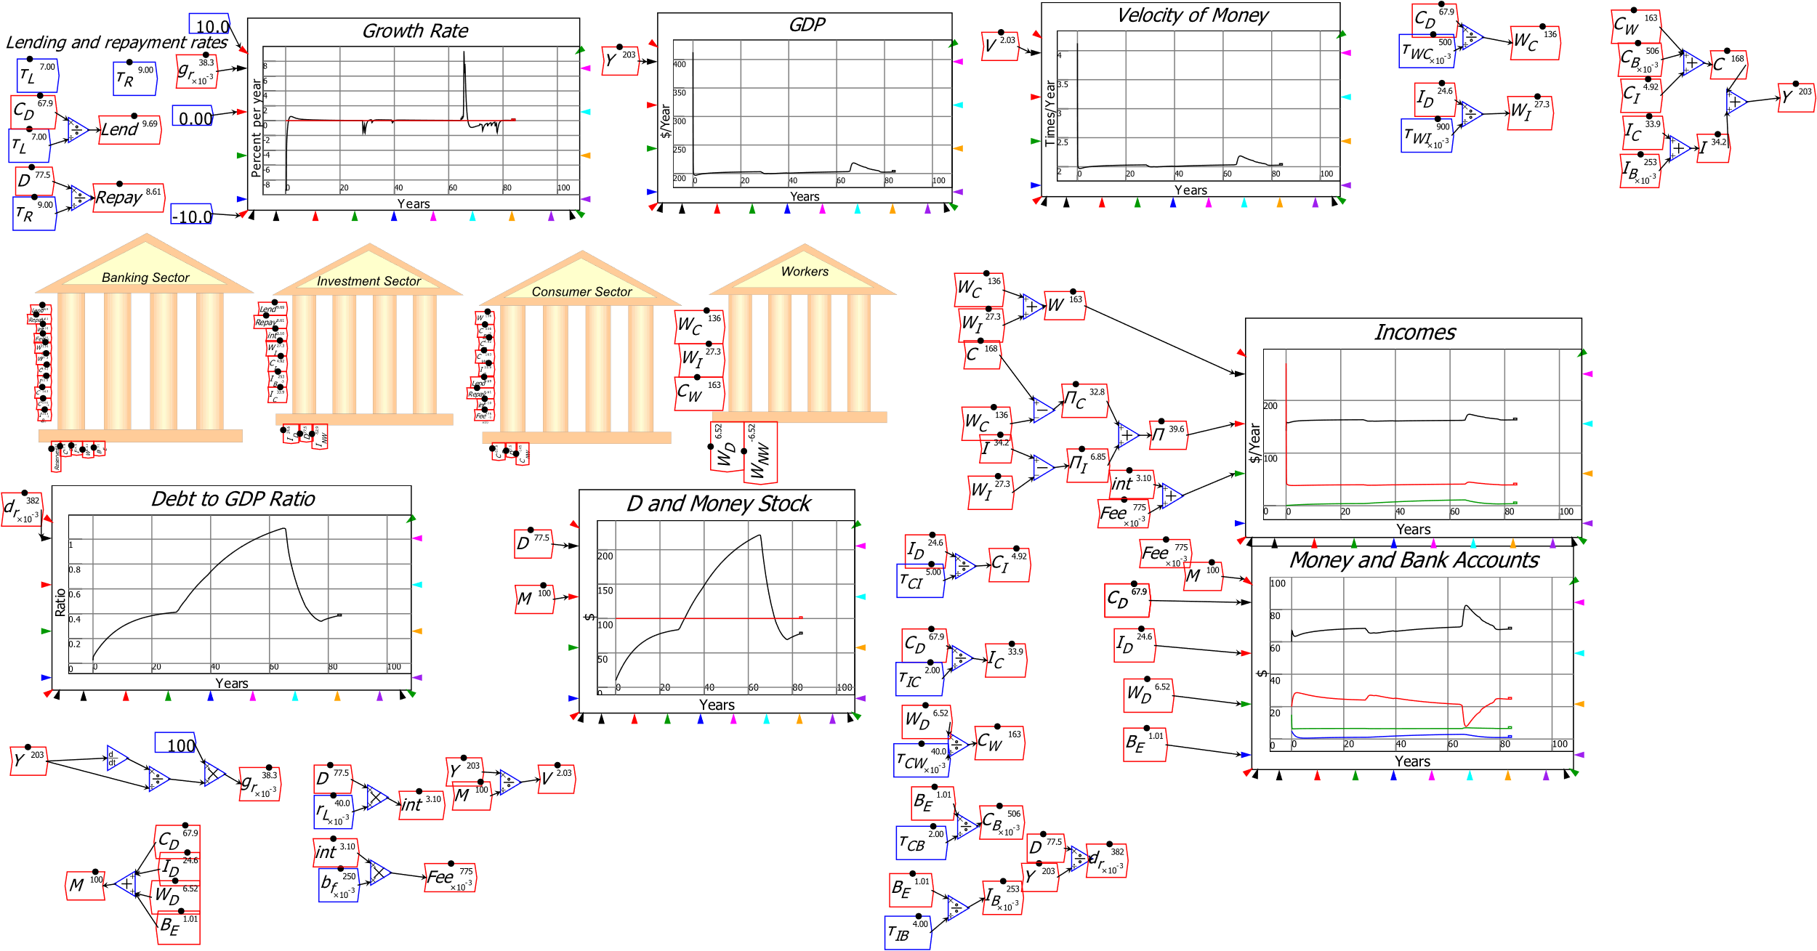
Modelling LF vs BOMD in Minsky
Illustrating this this in Minsky: system dynamics software supporting monetary modelling using double-entry bookkeeping…
Krugman & Eggertsson (2012 supplement) had Loanable Funds model
  “Patient” Consumer goods producing agent lends to “Impatient” Investment goods producing agent
  Bank charges “Intermediation Fee”
Huge changes in credit and debt
Trivial changes in GDP

Slide 11
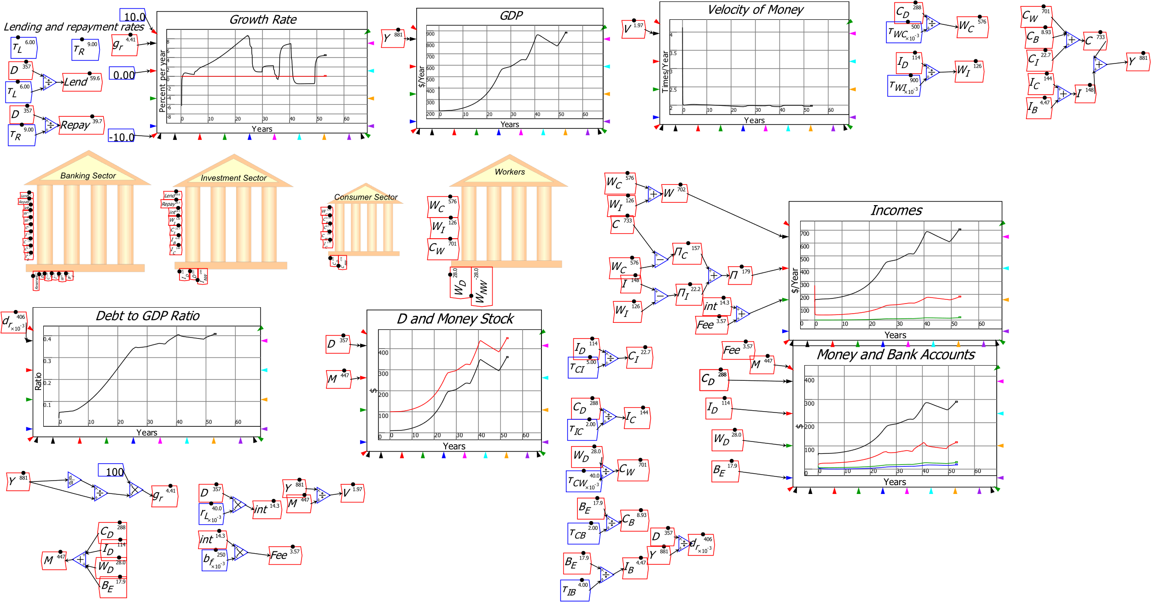
Modelling LF vs BOMD in Minsky
Easily modify it to BOMD…
Huge changes in credit and debt
Huge changes in GDP

Slide 12
Statistics support significance of Credit in GDP/Asset Pricing
Bank lending is not “pure redistribution” but a creation of money and spending power
By suppressing Fisher (& Schumpeter & even Pigou), economists set us up for 2008
Ignored & misunderstood the cause—debt bubble then credit collapse—before and after the crisis
Ohanian 2010: “The financial explanation also argues that the 2007-2009 recession became much worse because of a significant contraction of intermediation services. But some measures of intermediation have not declined substantially.
Figure 4 … shows that bank credit relative to nominal GDP rose at the end of 2008 to an all-time high. And while this declined by the first quarter of 2010, bank credit was still at a higher level at this point than any time before 2008.6 … These data suggest that aggregate quantities of intermediation volumes have not declined markedly.”

Slide 13
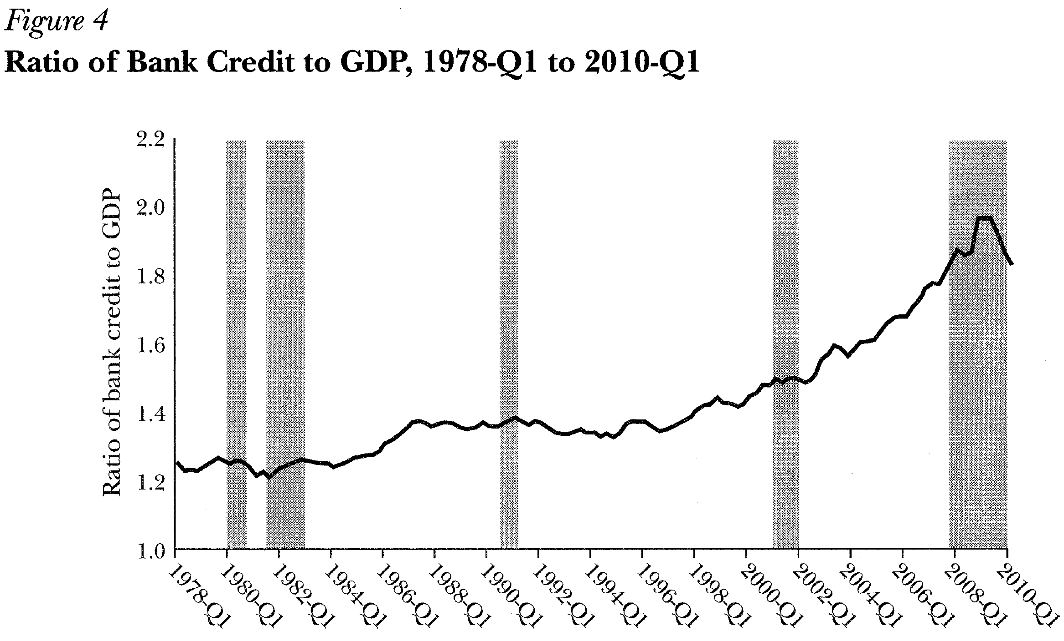
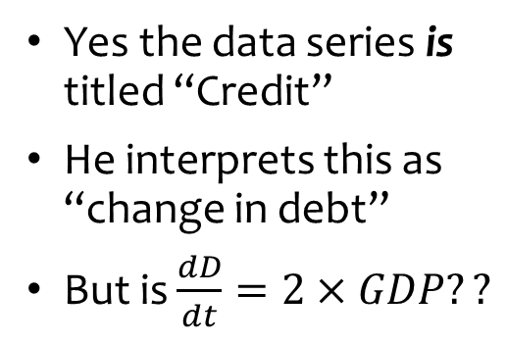
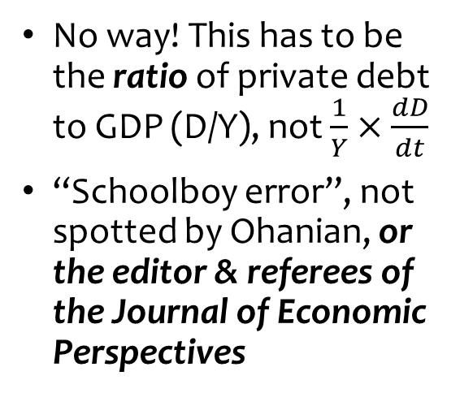
Why Mainstream Economics Ignores Credit
This is Ohanian’s Figure 4
Yes the data series is titled “Credit”
He interprets this as “change in debt”
But is $\frac{dD}{dt}=2×GDP??$
No way! This has to be the ratio of private debt to GDP (D/Y), not $\frac{1}{Y}×\frac{dD}{dt}$
“Schoolboy error”, not spotted by Ohanian, or the editor & referees of the Journal of Economic Perspectives

Slide 14
Statistics support significance of Credit in GDP/Asset Pricing
As the most volatile component of aggregate demand, credit dominates macroeconomics

Slide 15
Statistics support significance of Credit in GDP/Asset Pricing
Correlation of credit with unemployment in the USA since 1990 is minus 0.85

Slide 16
Statistics support significance of Credit in GDP/Asset Pricing
Correlation of change in household credit with real house price change is 0.71

Slide 17
The Quest for Foundations for Macroeconomics
Development Degeneration of macroeconomics driven by desire for sound foundations
  Lucas 2003: “I also held on to Patinkin’s ambition somehow, that the theory ought to be microeconomically founded, unified with price theory. I think this was a very common view.
  Nobody was satisfied with IS-LM as the end of macroeconomic theorizing. The idea was we were going to tie it together with microeconomics and that was the job of our generation.”
The wrong foundation: can’t build macro from micro:
  Anderson 1972: “The behavior of large and complex aggregates of elementary particles, it turns out, is not to be understood in terms of a simple extrapolation of the properties of a few particles.
  Instead, at each level of complexity entirely new properties appear, and the understanding of the new behaviors requires research which I think is as fundamental in its nature as any other.” (p. 393)

Slide 18
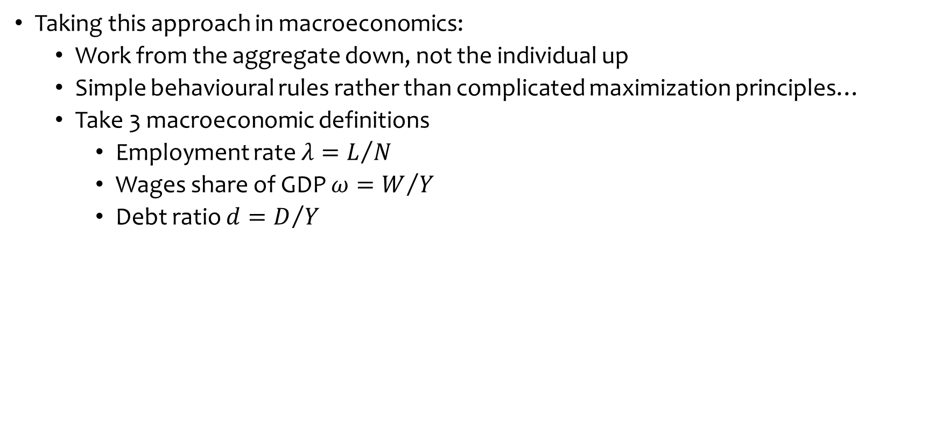
The Quest for Foundations for Macroeconomics
Taking this approach in macroeconomics:
  Work from the aggregate down, not the individual up
  Simple behavioural rules rather than complicated maximization principles…
  Take 3 macroeconomic definitions
    Employment rate $λ=L/N$
    Wages share of GDP $ω=W/Y$
    Debt ratio $d=D/Y$

Slide 19
A complex systems foundation for macroeconomics
Differentiate with respect to time to develop 3 dynamic definitions:
  The employment rate will rise if economic growth exceeds the sum of growth in labor productivity and population;
  The wages share of output will rise if wage demands exceed the growth in labor productivity; and
  The private debt to GDP ratio will rise if debt growth exceeds the rate of economic growth
Add simplest possible relationships between variables:
  Output Y_{R} a linear function of capital K_{R}
  Investment I_{R} a linear function of profit rate π_{r} (& depreciation)
  Employment a linear function of output
  Wage change a linear function of employment rate
  Change in debt equal to investment minus profits

Slide 20
A complex systems foundation for macroeconomics
Convert into a model with simplest possible relationships between variables
  Linear Capital: Output ratio, linear depreciation
Linear Phillips Curve
Linear Investment(Profit Rate) function
Debt finance when investment > profits
Constant growth in labour productivity & population

Slide 21
A complex systems foundation for macroeconomics
Simple system with 3 system states, 8 parameters & inherent nonlinearities
Comparable to Lorenz’s 3 equation model
  1 negative real eigenvalue, 2 complex eigenvalues
Real part of complex eigenvalues turns positive as π_{S}↑:

Slide 22
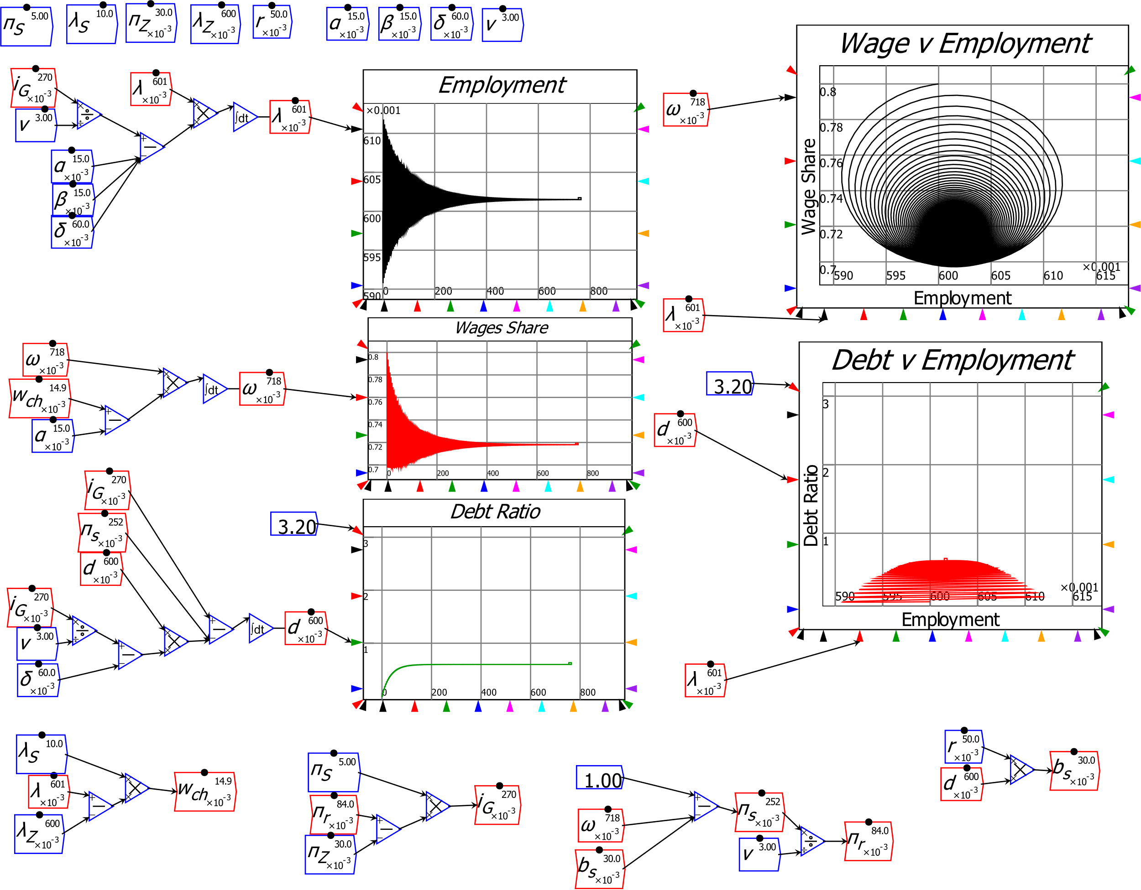
A complex systems foundation for macroeconomics
Resulting model has two meaningful (non-negative) equilibria
  “Good” equilibrium: positive employment rate, wages share, private debt ratio

Slide 23
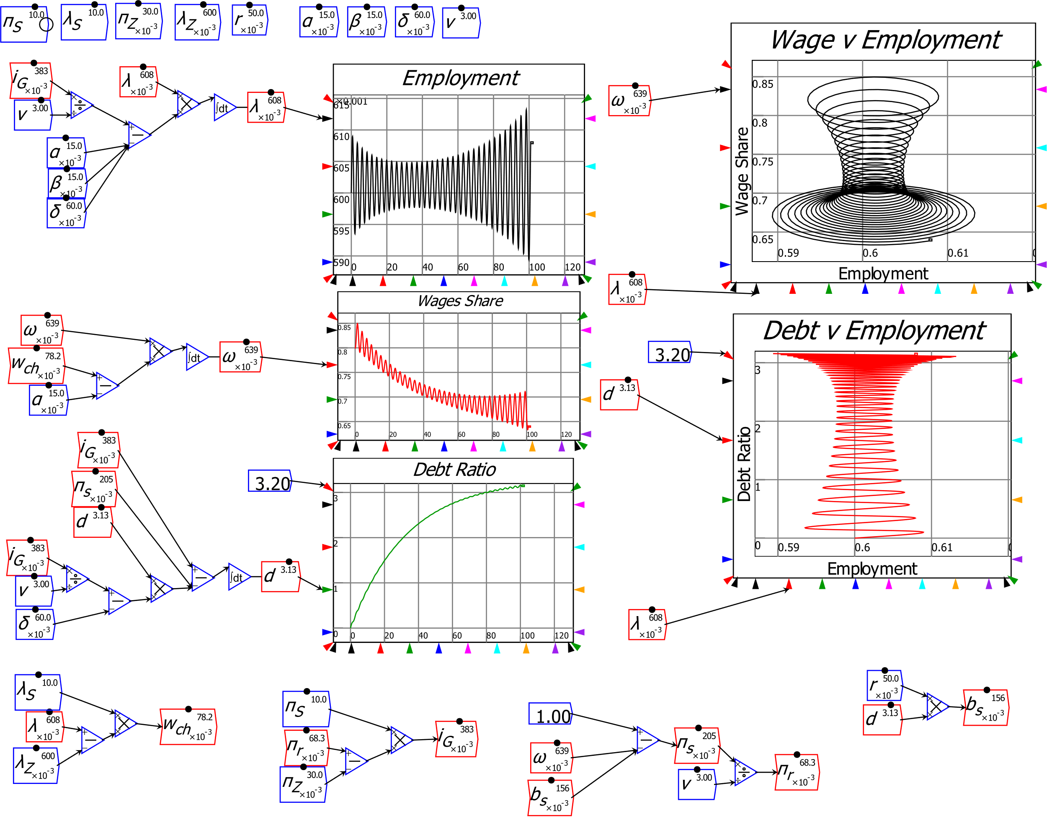
A complex systems foundation for macroeconomics
“Bad” equilibrium: zero employment rate, wages share, infinite debt ratio
High propensity to invest destabilizes the “good” equilibrium…
Highly stylized reproduction of “stylized facts” of last twenty years
Cyclically rising debt ratio
“Calm before the Storm”
“Great Moderation” followed by “Great Recession”
Pomeau-Manneville intermittent route to chaos
Rising inequality

Slide 24
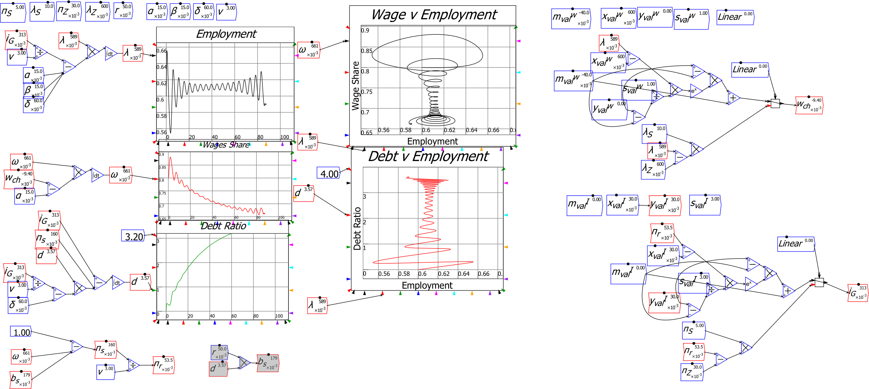
A complex systems foundation for macroeconomics
Nonlinear functions, government, variable capacity can all be added for more realism

Slide 25
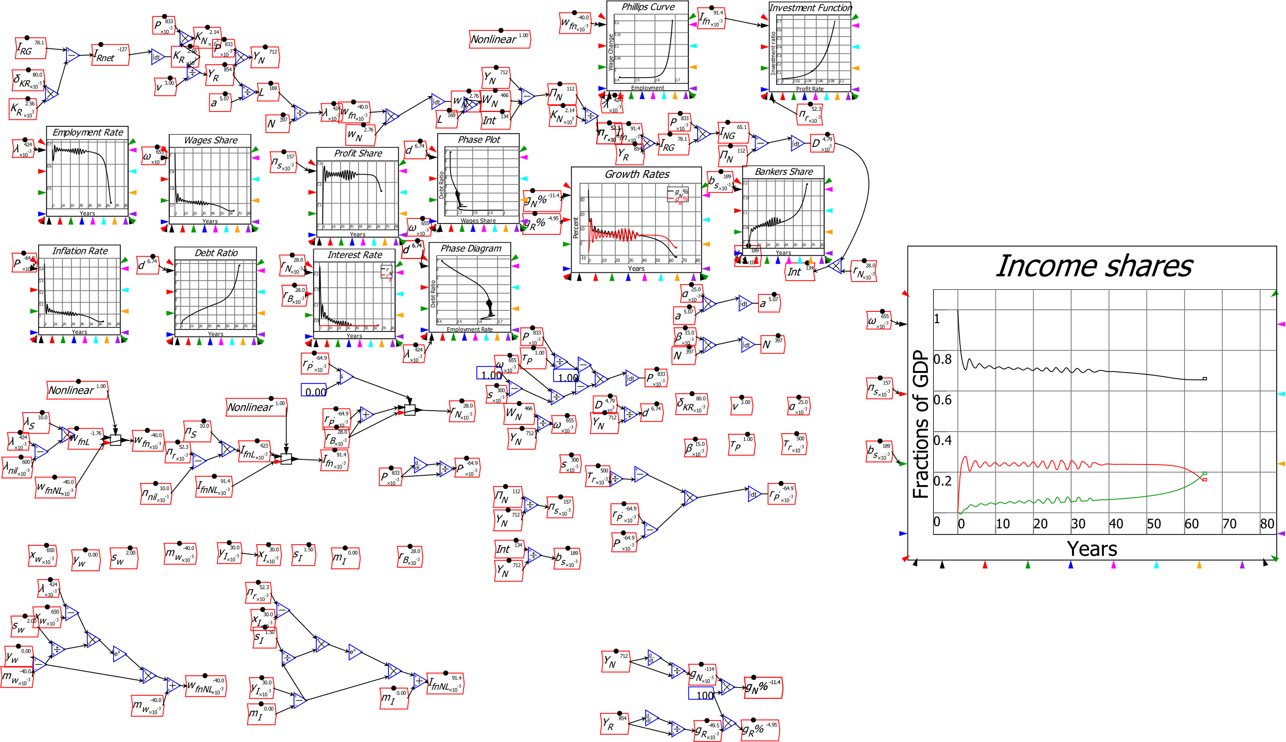
A complex systems foundation for macroeconomics
Model extended by extending definitions: prices, government, etc. (Prices shown here)
May learn more from carefully modelling structure of the economy than from modelling behaviour of agents in it…

Slide 26
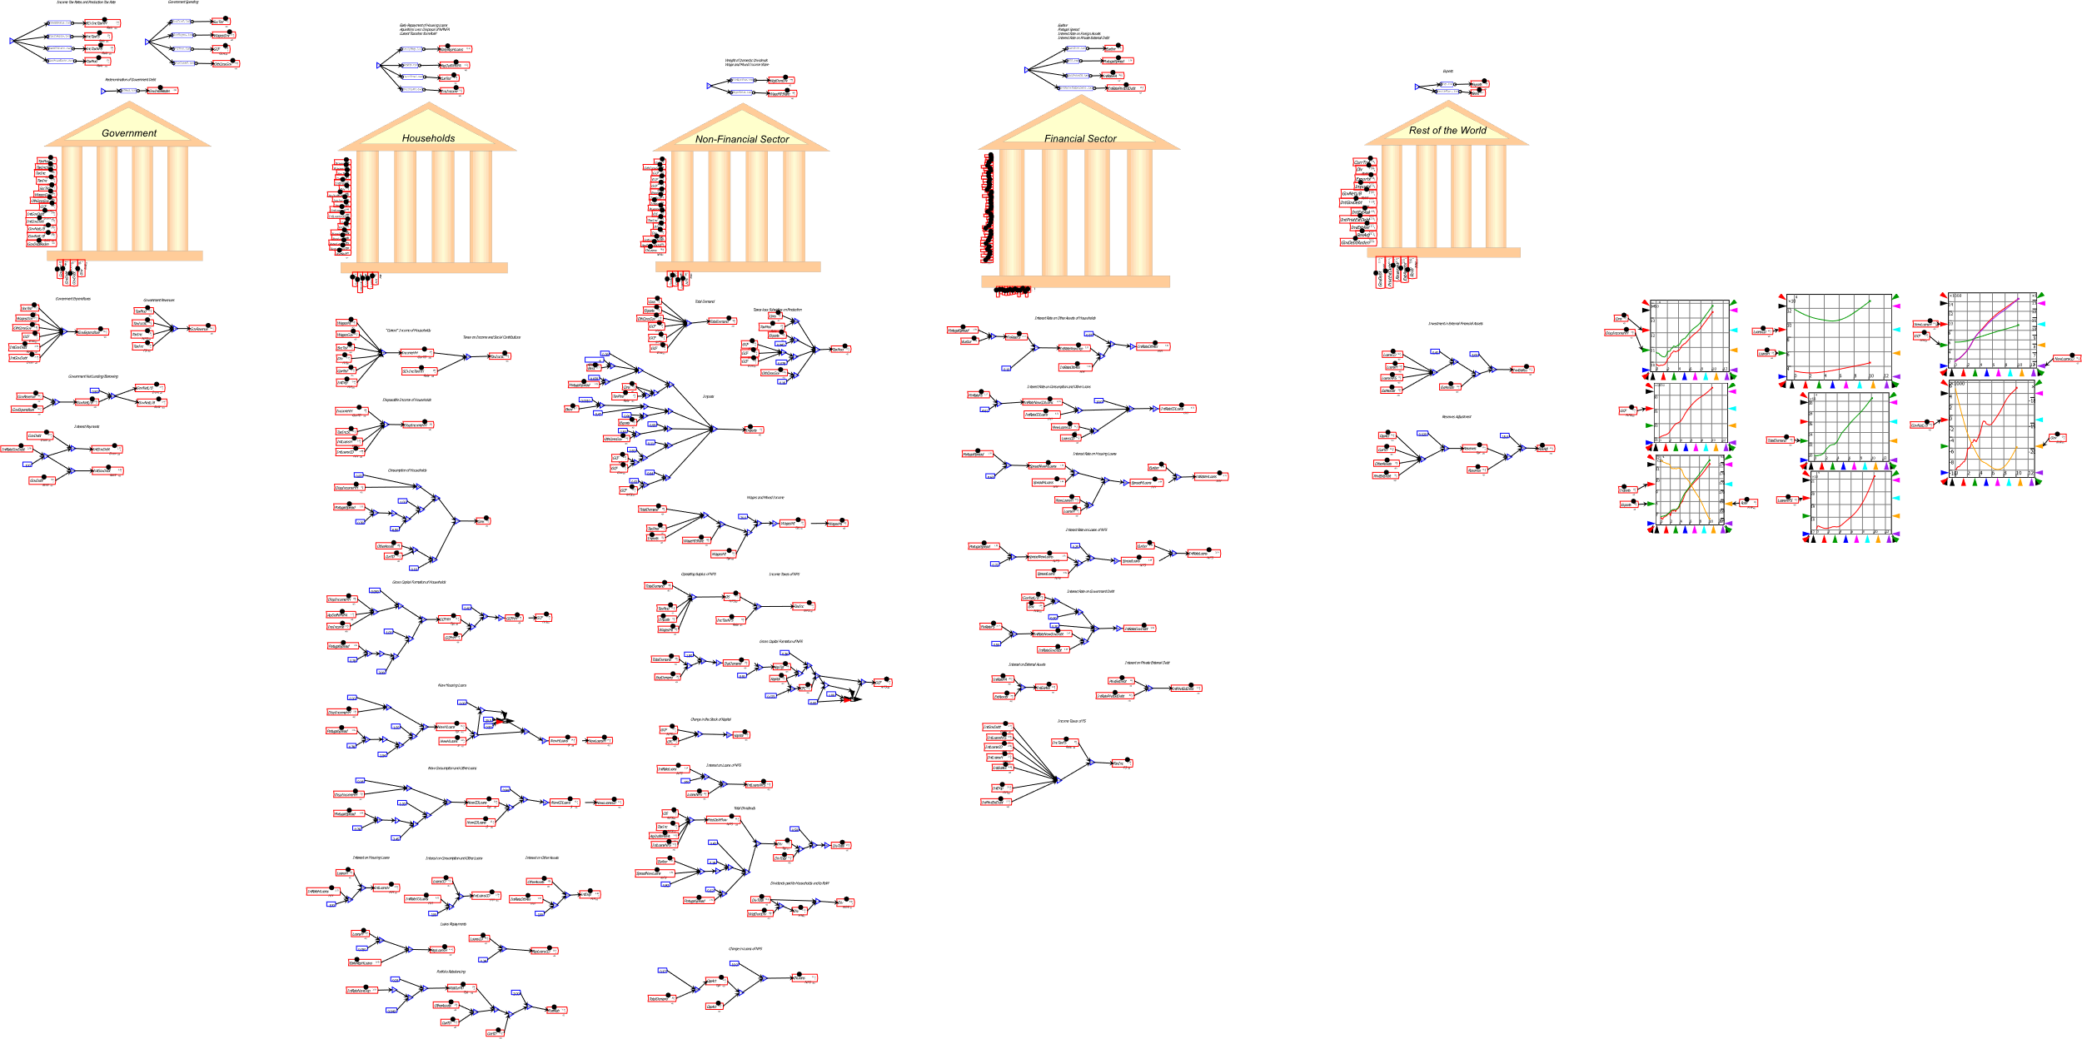
A monetary approach to macroeconomics
General Dynamics: far more elaborate models can be built & simulated:
5 sector model of Portuguese economy (Pratas, Portuguese Statistical Office)

Slide 27
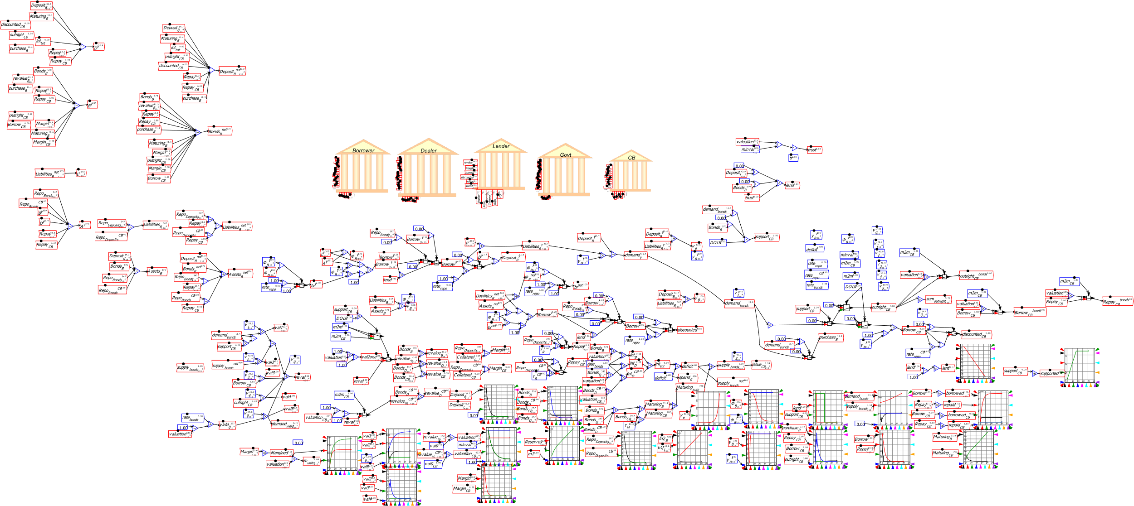
A monetary approach to macroeconomics
Stylized model of shadow banking (Jackson, Bank of England)

Slide 28
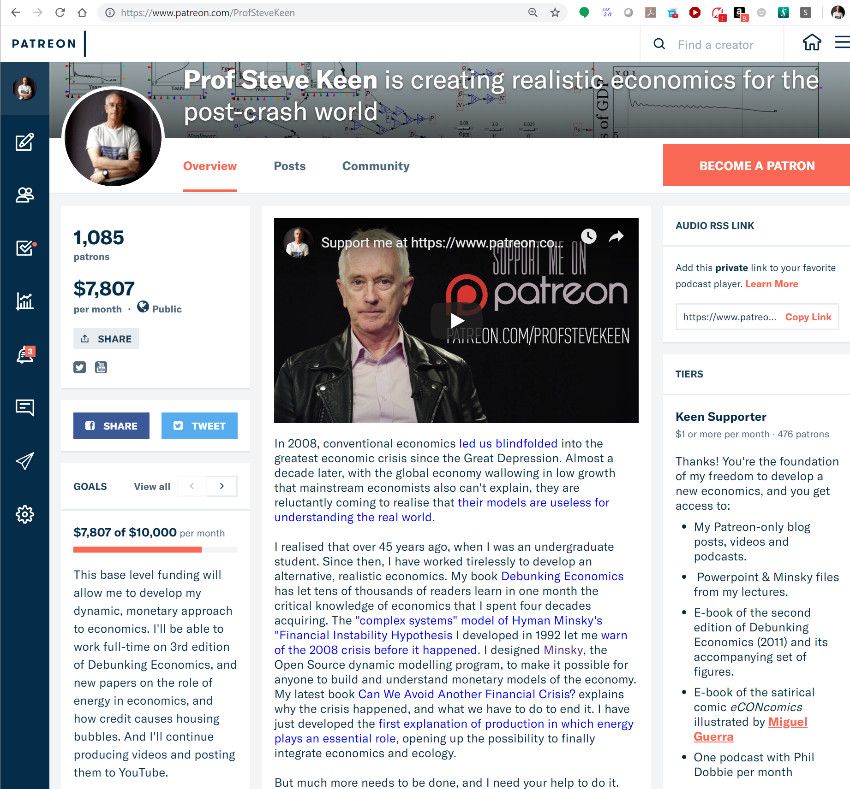
Economics needs to “grow up” & embrace dynamics
“A baby is expected to first crawl, then walk, before running. But what if a grown-up man is still crawling?
At present, the state of our dynamic economics is more akin to a crawl than to a walk, to say nothing of a run.
Indeed, some may think that capitalism as a social system may disappear before its dynamics are understood by economists.” (Blatt in 1982: it’s worse now!)
We need complex systems economics
Universities won’t develop it
  Mainstream excludes alternatives
  Bank of England, World Bank better
And economic rebels like me:
Especially about Climate Change…
https://www.patreon.com/ProfSteveKeen

Slide 29
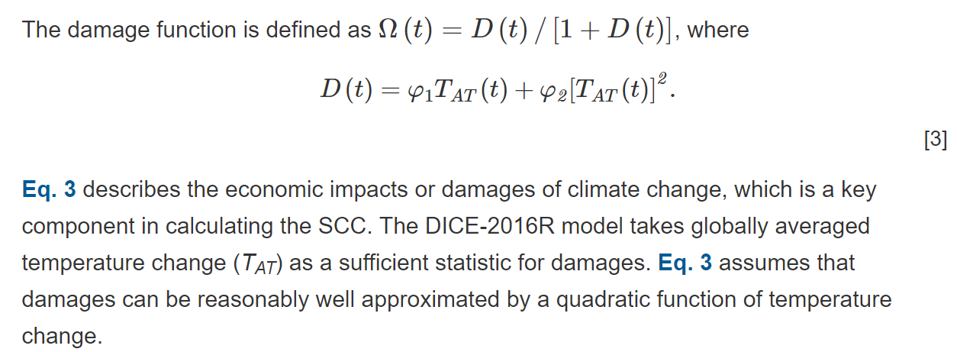
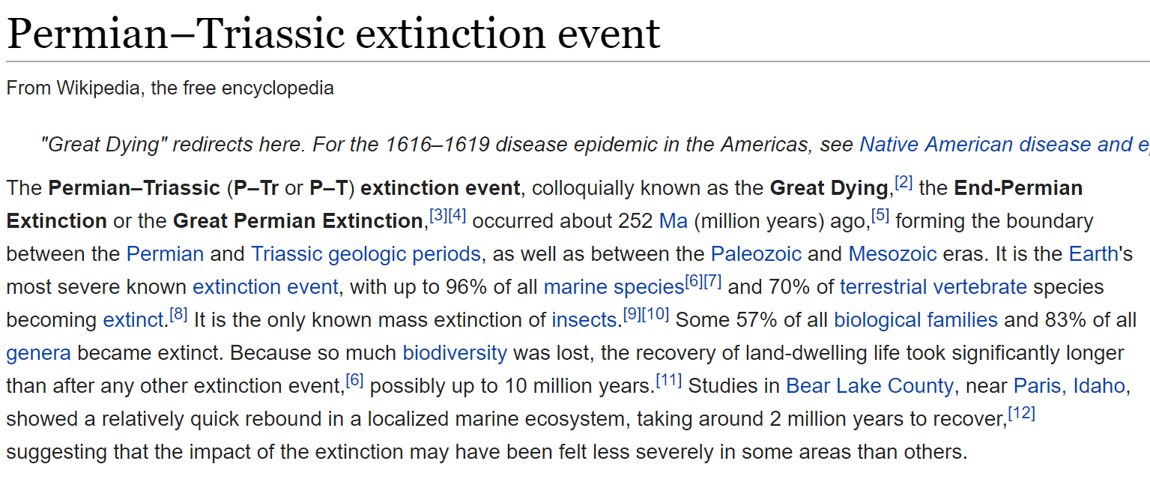
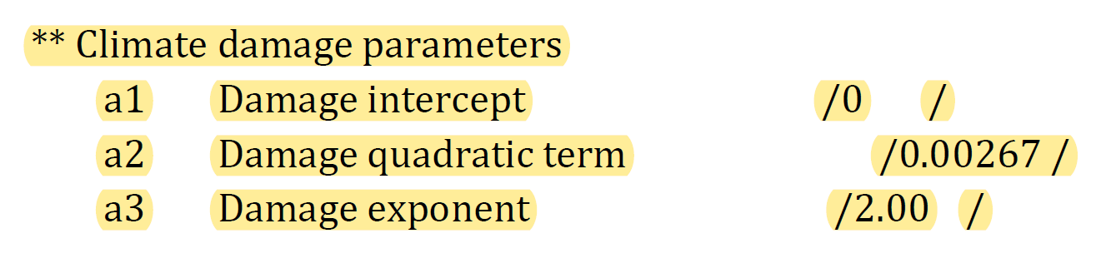
Especially about Climate Change
Nordhaus gets “Nobel” for ”integrating climate change into long-run macroeconomic analysis”?
  Norhaus 2017 “Revisiting the social cost of carbon”
“Including all factors, the final estimate is that the damages are 2.1% of global income at a 3 °C warming, and 8.5% of income at a 6 °C warming.”
WTF?
Only 8.5 fall in GDP%???
Last time planet was that hot was Permian Extinction: 80% of all species perished
How did he get this result? Read his “DICE” manual. He:
  “assumes that damages are a quadratic function of temperature change and
  does not include sharp thresholds or tipping points”
Nordhaus’s “damage function” is of the form $\frac{D\left(t\right)}{1+D\left(t\right)}$ where $D\left(t\right)=0.00267×t^{2}$…

Slide 30
Especially about Climate Change
His “degree of extinction” for temperature change from pre-industrial levels looks like
40% civilization destroyed
Average temperature zero
9% civilization destroyed
Average temperature Permian Extinction Level

Slide 31
Especially about Climate Change
Quadratic “damage function” nonsense
Absence of “sharp thresholds or tipping points” nonsense
Consider rational function with thresholds:
  Low Temperature rules out civilization (say, average temperature zero)
  High Temperature causes extinctions (Permian Extinction: 6 degrees hotter)
  Fit these functions to Nordhaus’s for “low” temperature changes (0.5-1.75)…

Slide 32
Especially about Climate Change
Not such a rosy picture:

Slide 33
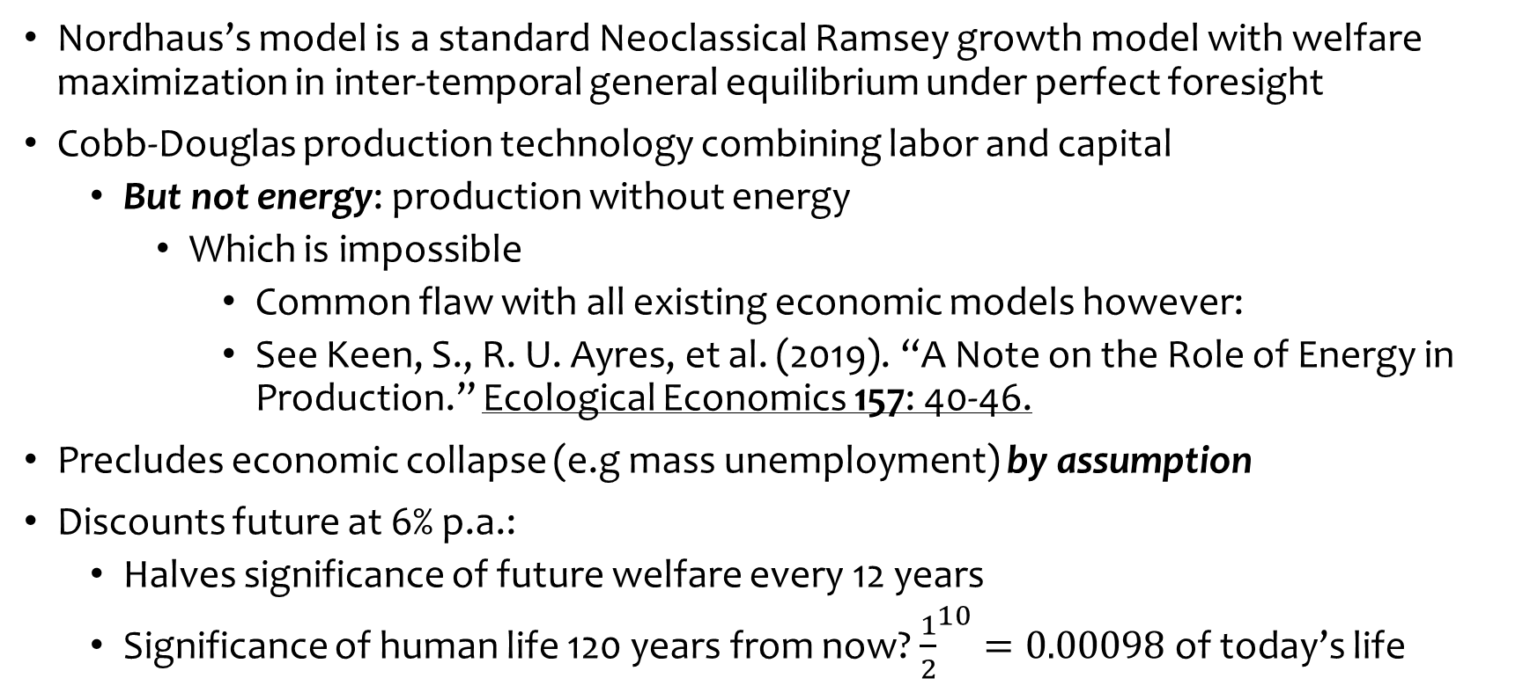
Especially about Climate Change
Nordhaus’s model is a standard Neoclassical Ramsey growth model with welfare maximization in inter-temporal general equilibrium under perfect foresight
Cobb-Douglas production technology combining labor and capital
  But not energy: production without energy
    Which is impossible
      Common flaw with all existing economic models however:
      See Keen, S., R. U. Ayres, et al. (2019). “A Note on the Role of Energy in Production.” Ecological Economics 157: 40-46.
Precludes economic collapse (e.g mass unemployment) by assumption
Discounts future at 6% p.a.:
  Halves significance of future welfare every 12 years
  Significance of human life 120 years from now? ${\frac{1}{2}}^{10}=0.00098$ of today’s life

Slide 34
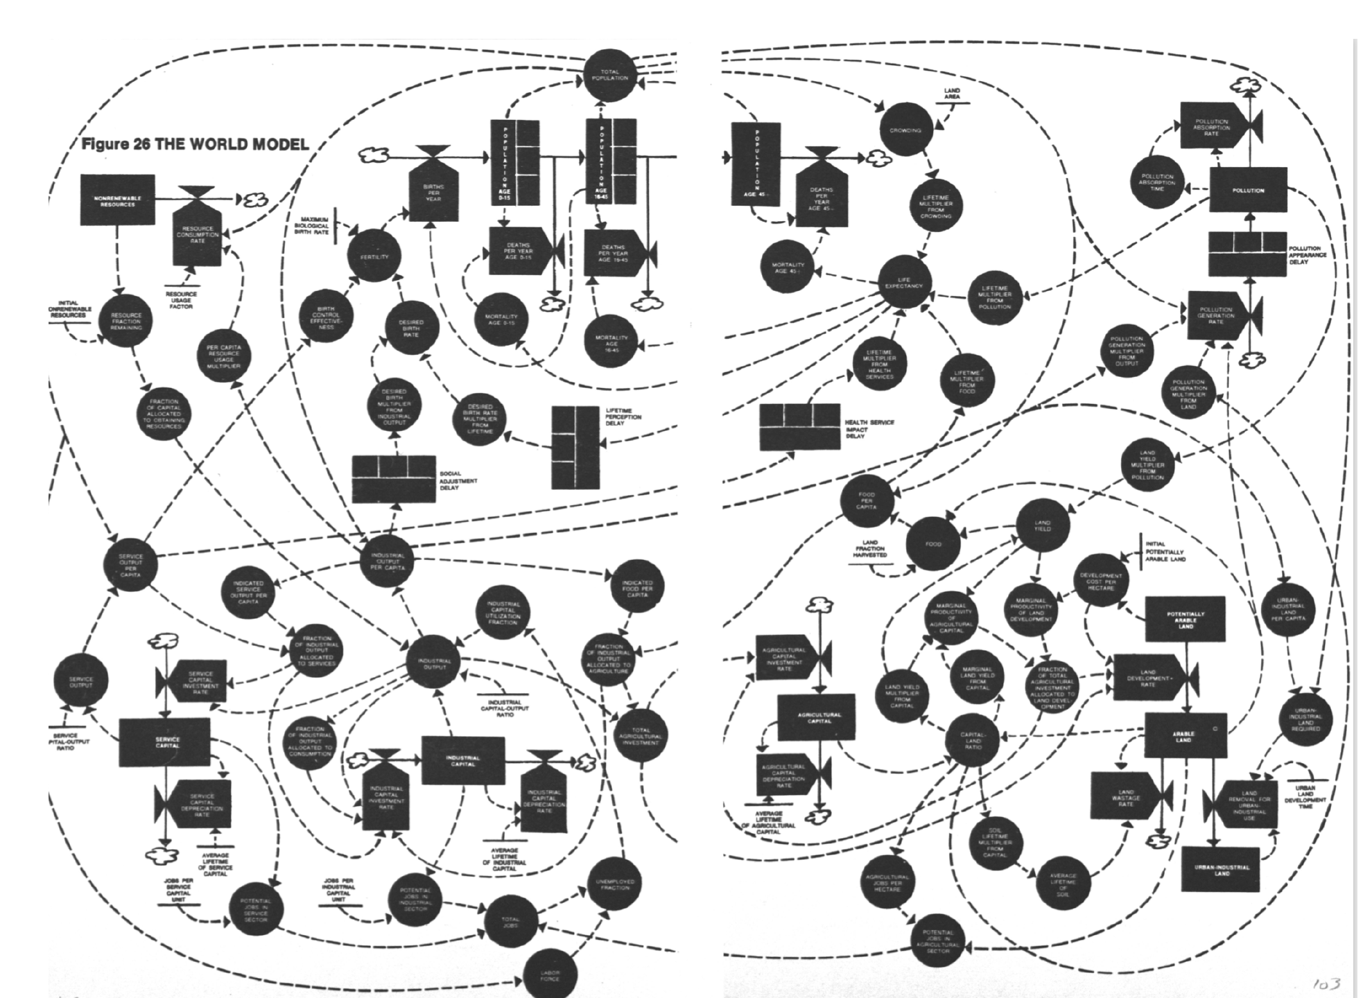
Especially about Climate Change
Nordhaus trashed system dynamics method of Limits to Growth
  But far more realistic system dynamics method
  Feedbacks between growth, resource depletion, population, pollution (effectively absent in Nordhaus)
Far more sensible for analysing dangers than arbitrary “damage function”
Genuinely dynamic and nonlinear versus Nordhaus’s Ramsey-equilibrium approach
Neoclassical economics is very bad for your health survival

