Slide 1
The Magnificent Failure of Neoclassical Economics
www.patreon.com/profstevekeen
www.profstevekeen.com

Slide 2
From the “Invisible Hand” to the “Rational Expectations”
Neoclassicals may think they have proven the existence of “the Invisible Hand”
But have they? From Smith: “by directing that industry in such a manner as its produce may be of the greatest value, he intends only his own gain, and he is in this, as in many other cases, led by an invisible hand to promote an end which was no part of his intention” (WON, p. 456)
  Vision of market causing socially beneficial outcome despite intentions of agents
To Sargent & Wallace: “The public knows the monetary authority’s feedback rule and takes this into account in forming its expectations… by virtue of the assumption that expectations are rational, there is no feedback rule that the authority can employ and expect to be able systematically to fool the public. This means that the authority cannot expect to exploit the Phillips Curve even for one period.” (1976, pp. 173, 178)
  Vision of all-knowing agents who achieve outcomes they “rationally” anticipate
From smart markets & “dumb” agents to agents who are “gods”

Slide 3
From the “Invisible Hand” to “Rational Expectations”
Why? Many intermediate steps, but fundamentally, virtually every time Neoclassicals wanted to mathematically prove “stability” they did the opposite
Walras’ vision of “tatonnement” leading to mutli-market equilibrium: “let us imagine a market in which only consumer goods and services are bought and sold…
  Once the prices or the ratios of exchange of all these goods and services have been cried at random …, each party to the exchange will offer at these prices those goods or services of which he thinks he has relatively too much, and he will demand those articles of which he thinks he has relatively too little…
  the prices of those things for which the demand exceeds the offer will rise, and the prices of those things of which the offer exceeds the demand will fall…
  And again prices will rise or fall until the demand and the offer of each good and each service are equal. Then the prices will be current equilibrium prices and exchange will effectively take place.” (Walras 1874)

Slide 4
From the “Invisible Hand” to “Rational Expectations”
Will this converge to equilibrium? Walras thought so:
  “This will appear probable if we remember that the change from p’b to p’’b, which reduced the above inequality to an equality, exerted a direct influence that was invariably in the direction of equality at least so far as the demand for (B) was concerned;
  while the [consequent] changes from p’c to p’’c, p’d to p’’d,, which moved the foregoing inequality farther away from equality, exerted indirect influences, some in the direction of equality and some in the opposite direction, at least so far as the demand for (B) was concerned, so that up to a certain point they cancelled each other out.
  Hence, the new system of prices (p’’b, p’’c, p’’d,) is closer to equilibrium than the old system of prices (p’b, p’c, p’d,); and it is only necessary to continue this process along the same lines for the system to move closer and closer to equilibrium.”

Slide 5
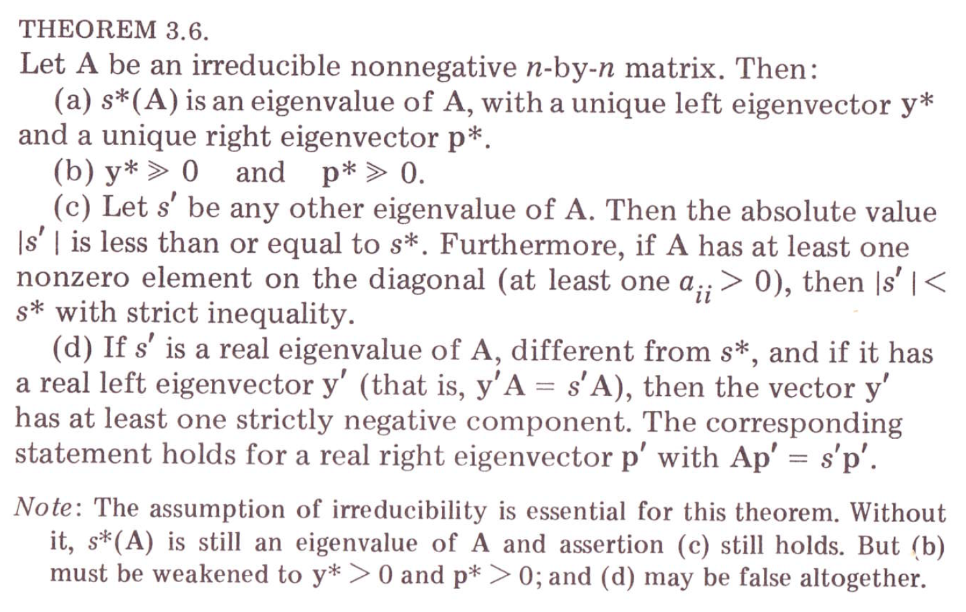
From the “Invisible Hand” to “Rational Expectations”
Mathematicians proved otherwise (by accident):
WTF?
I know what you’re (almost) all thinking
This is the “Perron-Frobenius Theorem”
SO?...

Slide 6
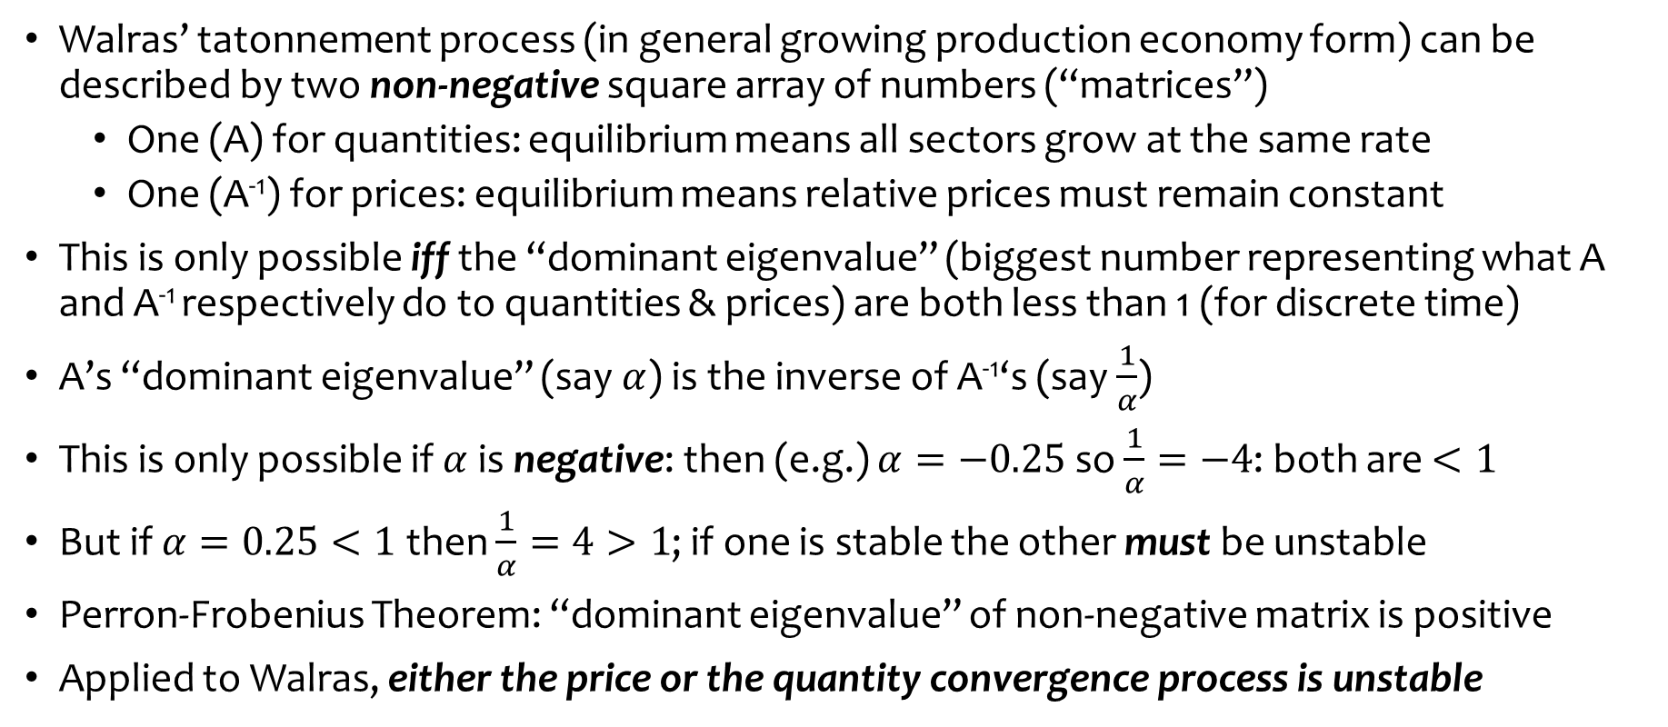
From the “Invisible Hand” to “Rational Expectations”
Walras’ tatonnement process (in general growing production economy form) can be described by two non-negative square array of numbers (“matrices”)
  One (A) for quantities: equilibrium means all sectors grow at the same rate
  One (A⁻¹) for prices: equilibrium means relative prices must remain constant
This is only possible iff the “dominant eigenvalue” (biggest number representing what A and A⁻¹ respectively do to quantities & prices) are both less than 1 (for discrete time)
A’s “dominant eigenvalue” (say $α$) is the inverse of A⁻¹‘s (say $\frac{1}{α}$)
This is only possible if $α$ is negative: then (e.g.) $α=−0.25$ so $\frac{1}{α}=−4$: both are $<1$
But if $α=0.25<1$ then $\frac{1}{α}=4>1$; if one is stable the other must be unstable
Perron-Frobenius Theorem: “dominant eigenvalue” of non-negative matrix is positive
Applied to Walras, either the price or the quantity convergence process is unstable

Slide 7
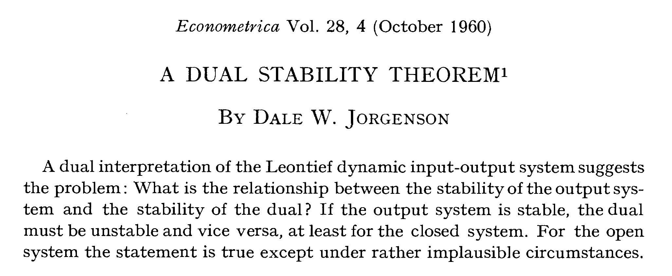
From the “Invisible Hand” to “Rational Expectations”
Called the “dual stability problem” in economics when economists discovered this maths in the 1960s…

Slide 8
From the “Invisible Hand” to “Rational Expectations”
Correct reaction to this discovery:
  Multi-sectoral price & quantity dynamics must be far-from-equilibrium processes
Actual reaction
  Pretend it can be handled with “suitable restrictions”:
    “Jorgenson's "suitable restrictions on the initial values of the disequilibrium variables" are so thoroughly "suitable" that any system whatever can thereby be proved to be stable:
    If there exists a "normal mode" of the system leading to instability, Jorgenson simply assumes that the initial amplitude of this particular mode (and of all such modes) is zero; in a linear system, such a "suitable restriction" indeed ensures that this mode has zero amplitude ever thereafter!” (Blatt 1982, p. 135)
  Ignore it and carry on anyway… CGE models ruled mainstream economics until…

Slide 9
From the “Invisible Hand” to “Rational Expectations”
Rational Expectations! Introduced by Muth to replace (unstable) “cobweb” model of price fluctuations with (stable) equilibrium process:
  “I should like to suggest that expectations, since they are informed predictions of future events, are essentially the same as the predictions of the relevant economic theory.” (Muth 1961, p. 316)
“Logical” justification for this?
  “Information is scarce, and the economic system generally does not waste it.”
Mmmm. So if it’s scarce, it has a price (Neoclassical idea), right, so a rational agent would buy information until its marginal benefit equals its marginal cost
So information would be incomplete, and differ from “the predictions of the relevant economic theory” (Let alone reality)?
  Nope! We assume it’s the same! So information (about the future!), which is scarce (I’ll say!), is also free…
Ultimately lead to RBC and DSGE models…

Slide 10
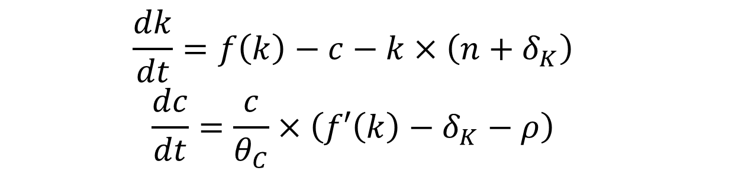
From “Rational Expectations” to RBC/DSGE models
Based on Ramsey’s 1928 “Optimum Savings” paper. Reduces to two equations…
Production function
Population growth rate
Depreciation rate
Rate of change of capital-labor ratio
  $$\frac{dk}{dt}=f\left(k\right)−c−k×\left({n+δ}_{K}\right)$$
  $$\frac{dc}{dt}=\frac{c}{θ_{C}}×\left(f′\left(k\right)−δ_{K}−ρ\right)$$
Rate of change of per capita consumption
Factor measuring “consumer’s” desire to smooth consumption over time.
1st derivative of production function with respect to k
rate of time preference
Apply local stability analysis …

Slide 11
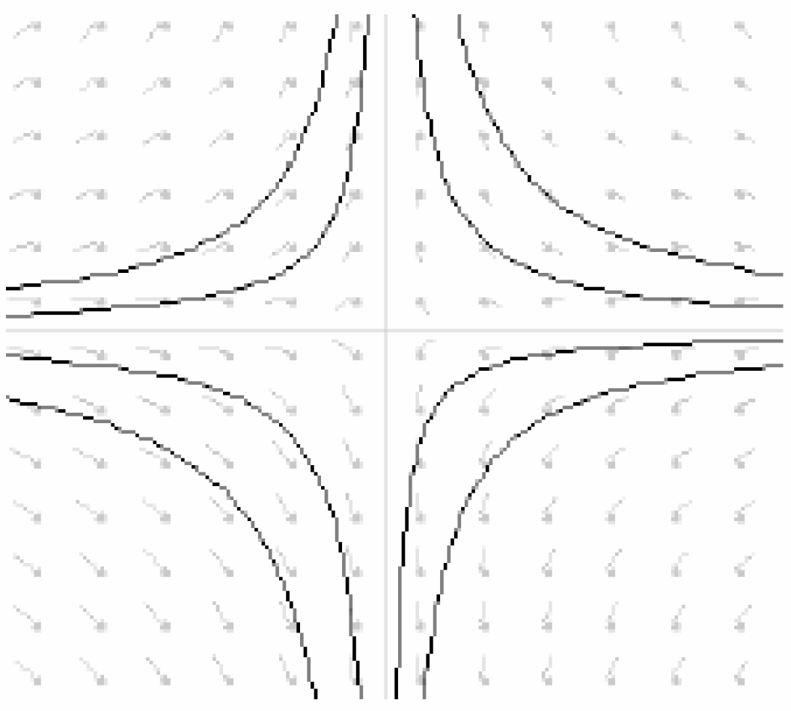
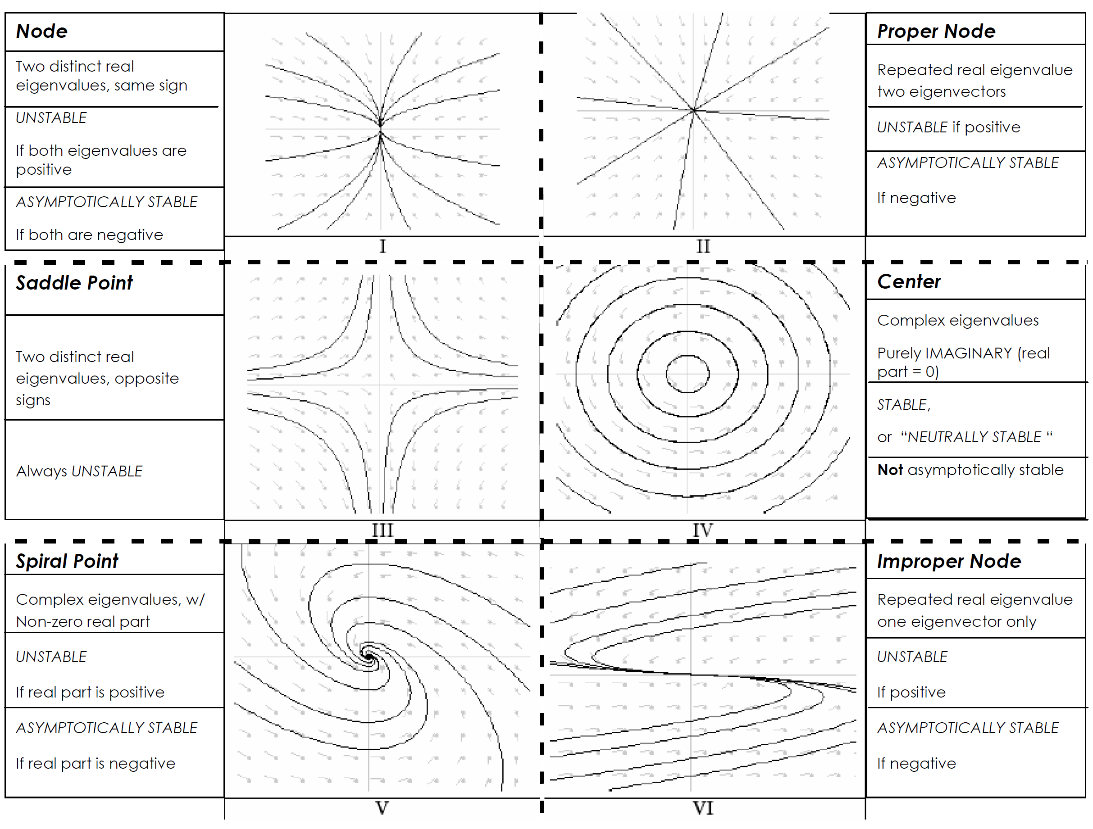
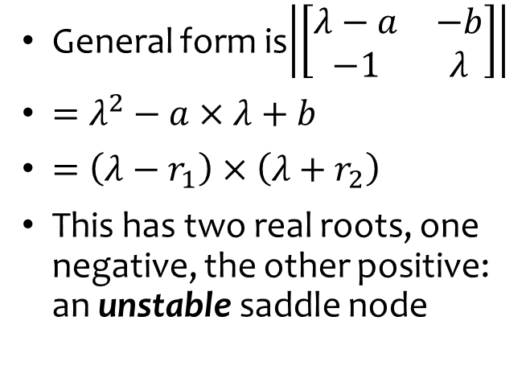
From “Rational Expectations” to RBC/DSGE models
General form is$\left|\left[\begin{matrix}λ−a & −b \\ −1 & λ\end{matrix}\right]\right|$
$=λ^{2}−a×λ+b$
$=\left(λ−r_{1}\right)×\left(λ+r_{2}\right)$
This has two real roots, one negative, the other positive: an unstable saddle node
c post-shock
Neoclassical “solution” is
Take initial value of k as given
Treat consumption as a “jump” variable that can change instantly to land on the stable node
Change in consumption instantly causes opposite change in savings → investment
Jump
Converge over time
c pre-shock

Slide 12
Notice a pattern here?
Belief that capitalism is an equilibrium system
Prove that (some way of modelling) it is unstable
Ignore/distort result
Build elaborate mythematical framework to work around it
Rinse and repeat…
Results in extremely complicated pseudo-mathematical models
A magnificent failure:
  Models so complicated that practitioners believe they must be “scientific”
As scientific as Ptolemy’s “epicycles”, given belief that the Earth is centre of the Universe
But if we accept that disequilibrium—in fact, far from equilibrium—is the norm…

Slide 13

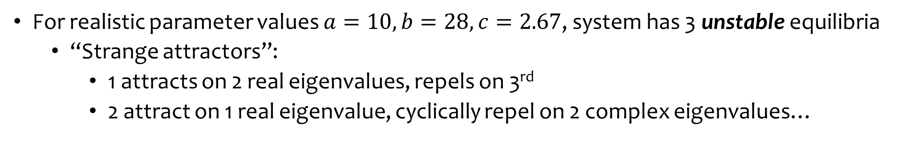
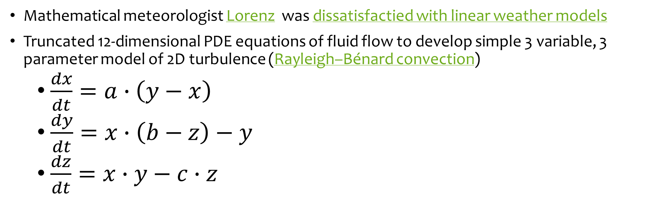
Complex systems rather than equilibrium
Mathematical meteorologist Lorenz was dissatisfactied with linear weather models
Truncated 12-dimensional PDE equations of fluid flow to develop simple 3 variable, 3 parameter model of 2D turbulence (Rayleigh–Bénard convection)
  $\frac{dx}{dt}=a∙\left(y−x\right)$
  $\frac{dy}{dt}=x∙\left(b−z\right)−y$
  $\frac{dz}{dt}=x∙y−c∙z$
Simple model, complex behaviour:
For realistic parameter values $a=10,b=28,c=2.67$, system has 3 unstable equilibria
  “Strange attractors”:
    1 attracts on 2 real eigenvalues, repels on 3rd
    2 attract on 1 real eigenvalue, cyclically repel on 2 complex eigenvalues…

Slide 14
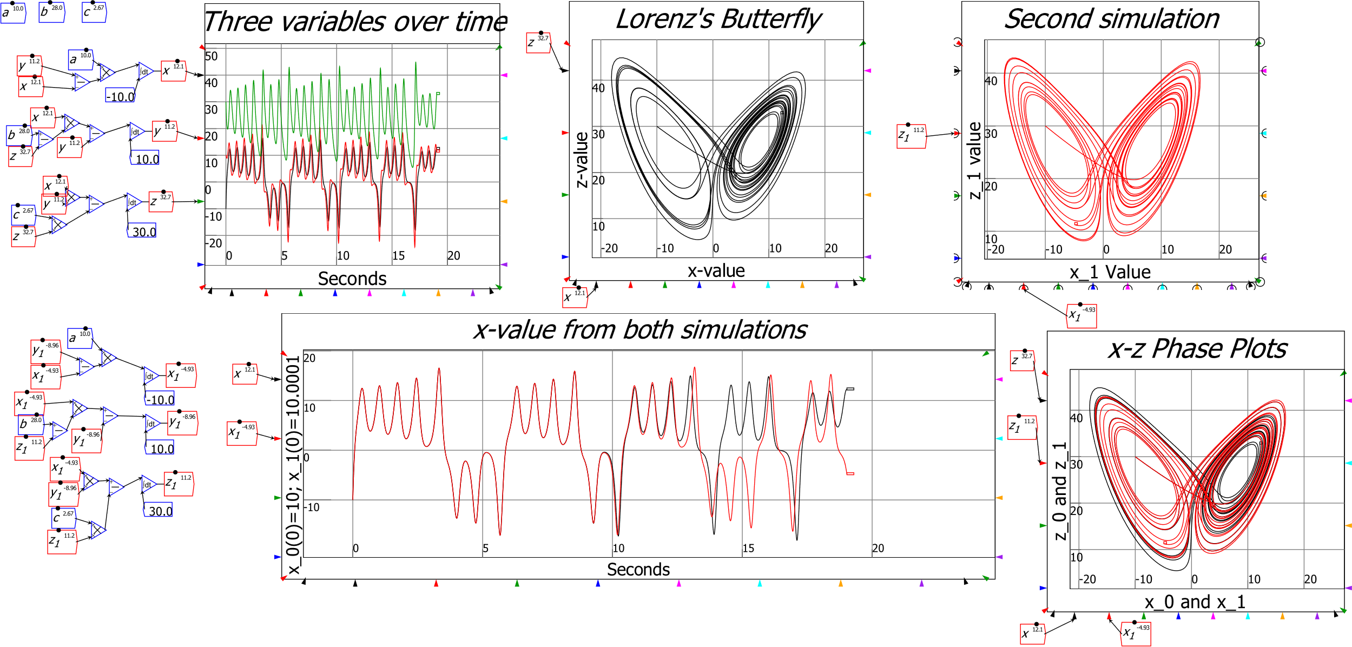
Complex systems rather than equilibrium
Result is cyclical aperiodic motion: “Deterministic Aperiodic Flow”

Slide 15
The Role of Banks, Debt & Credit in Macroeconomics
Desire to avoid disequilibrium is why they didn’t see the 2008 crisis coming…
Most non-economists think economists must be experts on money
  In fact, they’re experts at dreaming up reasons to ignore money
Loanable Funds model: banks are “intermediaries” between savers & borrowers
  Banks/Debt/Credit don’t matter, because “Absent implausibly large differences in marginal spending propensities among the groups… pure redistributions should have no significant macro-economic effects.” (Bernanke, 2000, p. 24)
Great model! Just one problem:
  It’s utter bollocks...

Slide 16
The Role of Banks, Debt & Credit in Macroeconomics
Central Banks reject Loanable Funds/Money Multiplier models of banking:
  Bank of England 2014: “Rather than banks receiving deposits when households save and then lending them out, bank lending creates deposits.”
  Bundesbank 2017: “look at the creation of (book) money as a set of straightforward accounting entries … money and credit are created as the result of complex interactions between banks, non- banks and the central bank.
    “this refutes a popular misconception that banks act simply as intermediaries at the time of lending – i.e. that banks can only grant credit using funds placed with them previously as deposits by other customers.”
  Bank of England 2014: “In normal times, the central bank does not fix the amount of money in circulation, nor is central bank money ‘multiplied up’ into more loans and deposits.”
  Bundesbank 2017: “And a bank’s ability to grant loans and create money has nothing to do with whether it already has excess reserves or deposits at its disposal.”

Slide 17
The Role of Banks, Debt & Credit in Macroeconomics
Technical issue clear: banks do not intermediate, but originate money & debt
But what are the macroeconomic implications? Conflicting mainstream views:
  OLG models: no significant implications (Faure and Gersbach 2017)
    “all the newly detected phenomena linked to money creation are connected to the presence of risks and bank default.
    In the absence of idiosyncratic and aggregate risks, the loanable-funds and the money-creation approaches are equivalent, since the allocations are identical.” (p. 2)
  DSGE models: significant implications (Kumhof and Jakab 2015)
    “Compared to otherwise identical intermediation models, and following identical shocks, financing models predict changes in bank lending that are far larger, happen much faster, and have much greater effects on the real economy.” (p. i)
Both views cannot be right. So which one is correct?

Slide 18
The Role of Banks, Debt & Credit in Macroeconomics
A logical analysis: derive relative impact from identity of Aggregate Demand & Supply
Divide economy into 3 sectors, where each sector spends on the other two
3x3 “Moore Table”: diagonal is expenditure (-), off-diagonal is income (+)
Each row must sum to zero: (Your) Expenditure IS (Someone Else’s) Income
Column sum can be non-zero: sectoral incomes can differ from expenditures
3 monetary arrangements
  “Say’s Law”: no lending possible
  “Loanable Funds”: lending between two sectors (along diagonal)
  “Bank Originated Money & Debt”: Bank (4th sector) lends to one sector
    Its Assets (not shown in Table) rise in tandem with new net lending

Slide 19
The Role of Banks, Debt & Credit in Macroeconomics
Firstly, “Say’s Law”: Expenditure only from existing money, no lending/borrowing
Expenditure by sector 1
Income generated by sector 1’s expenditure
Income for sector 1
Effectively Friedman’s “Quantity theory of money”
  Aggregate Demand ≡ Aggregate Income = money times velocity of circulation

Slide 20
The Role of Banks, Debt & Credit in Macroeconomics
“Loanable Funds”
  Sector 2 lends to sector 1 (flow across trace)
  Sector 1 pays interest to sector 2
  Sector 1 spends on sector 3
Expenditure of credit
Flow of credit
Credit cancels out
  IF loanable funds were true, THEN banking could be ignored in macroeconomics

Slide 21
The Role of Banks, Debt & Credit in Macroeconomics
“Bank Originated Money and Debt”: Bank lending (to sector 1) creates money
Sector 1 spends this money on sector 3
Credit (increase in Bank Liabilities) created by increase in debt (Bank assets—not shown)
Credit does not cancel out
  SINCE BOMD is true, THEN banking cannot be ignored in macroeconomics
  Credit is the most volatile component of aggregate demand and income

Slide 22
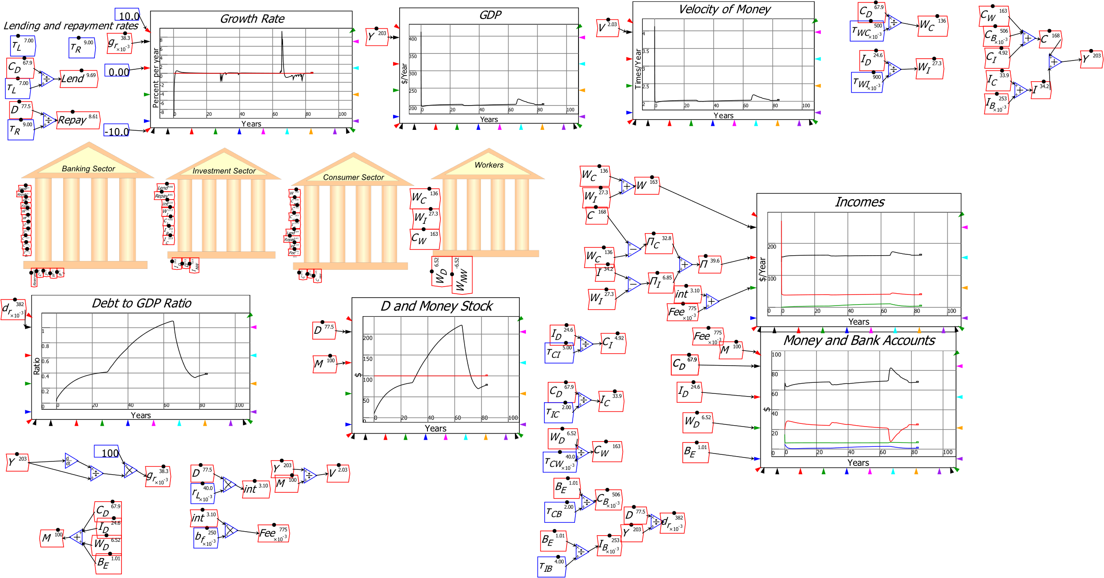
Modelling LF vs BOMD in Minsky
Illustrating this this in Minsky: system dynamics software supporting monetary modelling using double-entry bookkeeping…
Krugman & Eggertsson (2012 supplement) had Loanable Funds model
  “Patient” Consumer goods producing agent lends to “Impatient” Investment goods producing agent
  Bank charges “Intermediation Fee”
Huge changes in credit and debt
Trivial changes in GDP

Slide 23
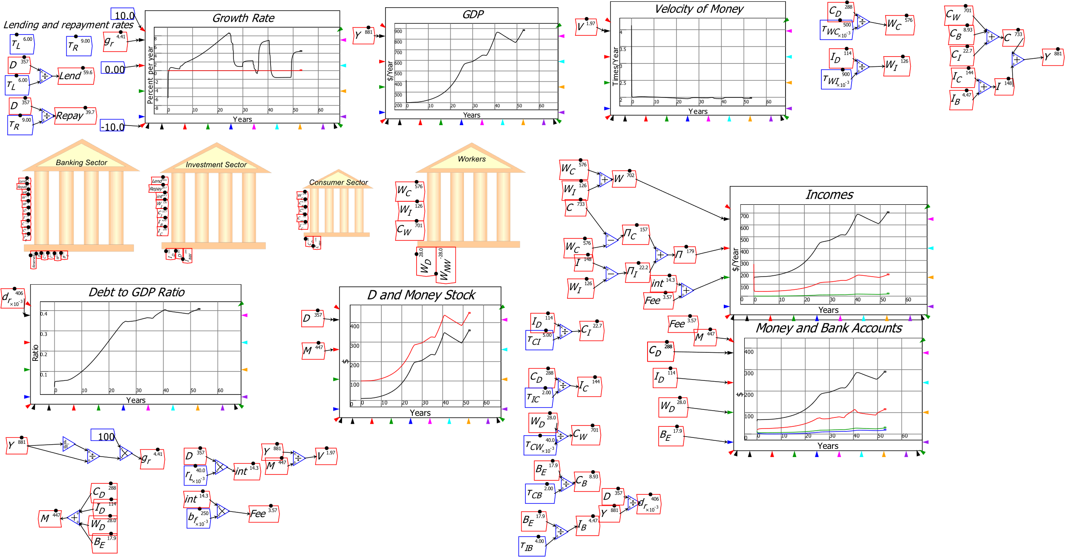
Modelling LF vs BOMD in Minsky
Easily modify it to BOMD…
Huge changes in credit and debt
Huge changes in GDP

Slide 24
Statistics support significance of Credit in GDP/Asset Pricing
Following Loanable Funds, leading Central Bank figures ignored credit
Bank lending is not “pure redistribution” but a creation of money and spending power
  Well understood by Fisher: “A man-to-man debt may be paid without affecting the volume of outstanding currency j for whatever currency is paid by one, whether it be legal tender or deposit currency transferred by check, is received by the other, and is still outstanding.
  But when a debt to a commercial bank is paid by check out of a deposit balance, that amount of deposit currency simply disappears.” (Fisher 1932, Booms and Depressions, p. 15)
By forgetting Fisher (& Schumpeter & even Pigou), economists set us up for 2008

Slide 25
Statistics support significance of Credit in GDP/Asset Pricing
As the most volatile component of aggregate demand, credit dominates macroeconomics

Slide 26
Statistics support significance of Credit in GDP/Asset Pricing
Correlation of credit with unemployment in the USA since 1990 is minus 0.85
Causation runs from credit to aggregate demand (as shown in Moore Table)
Similar results for all other countries in BIS database
  (Except Germany!
    Huge trade surplus plus government austerity
    Low/falling credit usage)

Slide 27
Statistics support significance of Credit in GDP/Asset Pricing
Correlation of change in household credit with real house price change is 0.71
Granger causality test confirms causation from change in household credit (acceleration of household debt) to change in inflation-adjusted house price index

Slide 28
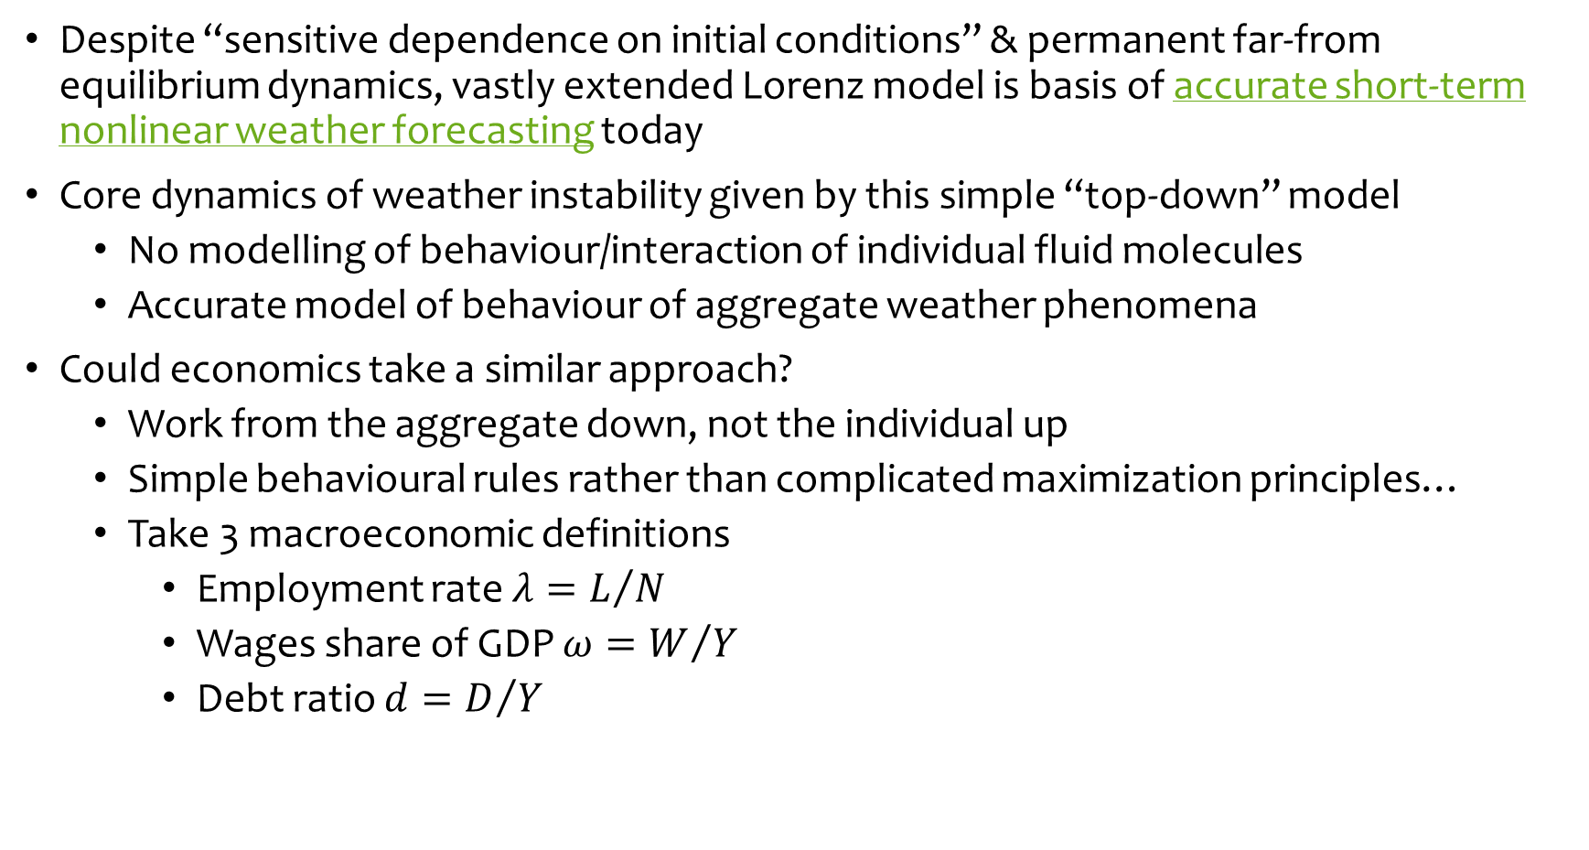
The Quest for Foundations for Macroeconomics
Despite “sensitive dependence on initial conditions” & permanent far-from equilibrium dynamics, vastly extended Lorenz model is basis of accurate short-term nonlinear weather forecasting today
Core dynamics of weather instability given by this simple “top-down” model
  No modelling of behaviour/interaction of individual fluid molecules
  Accurate model of behaviour of aggregate weather phenomena
Could economics take a similar approach?
  Work from the aggregate down, not the individual up
  Simple behavioural rules rather than complicated maximization principles…
  Take 3 macroeconomic definitions
    Employment rate $λ=L/N$
    Wages share of GDP $ω=W/Y$
    Debt ratio $d=D/Y$

Slide 29
A complex systems foundation for macroeconomics
Illustration of complex systems approach
Differentiate with respect to time to develop 3 dynamic definitions:
  The employment rate will rise if economic growth exceeds the sum of growth in labor productivity and population;
  The wages share of output will rise if wage demands exceed the growth in labor productivity; and
  The private debt to GDP ratio will rise if debt growth exceeds the rate of economic growth
Add simplest possible relationships between variables:
  Output Y_{R} a linear function of capital K_{R}
  Investment I_{R} a linear function of profit rate π_{r} (& depreciation)
  Employment a linear function of output
  Wage change a linear function of employment rate
  Change in debt equal to investment minus profits

Slide 30
A complex systems foundation for macroeconomics
Convert into a model with simplest possible relationships between variables
  Linear Capital: Output ratio, linear depreciation
Linear Phillips Curve
Linear Investment(Profit Rate) function
Debt finance when investment > profits
Constant growth in labour productivity & population

Slide 31
A complex systems foundation for macroeconomics
Simple system with 3 system states, 8 parameters & inherent nonlinearities
Comparable to Lorenz’s 3 equation model
  1 negative real eigenvalue, 2 complex eigenvalues
Real part of complex eigenvalues turns positive as π_{S}↑:

Slide 32
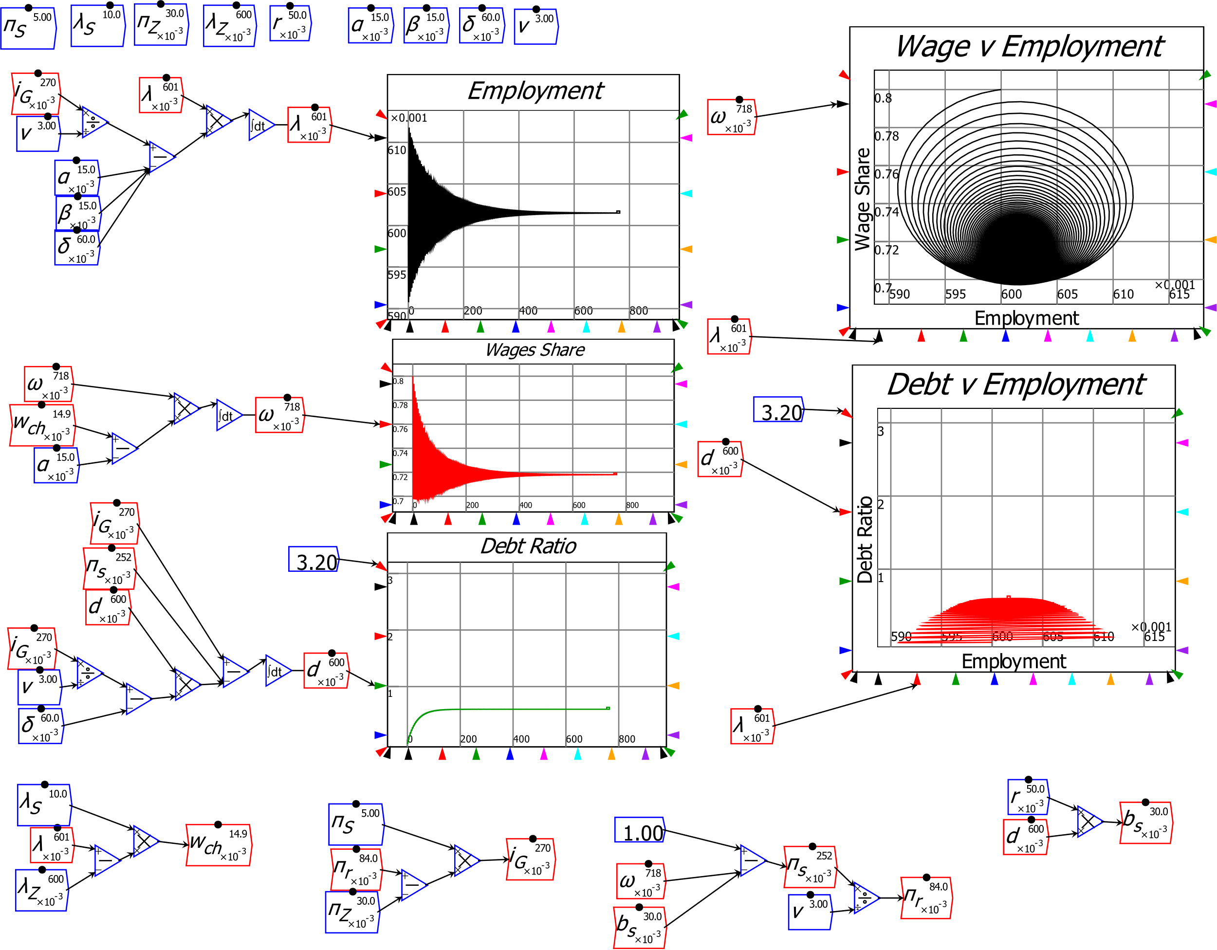
A complex systems foundation for macroeconomics
Resulting model has two meaningful (non-negative) equilibria
  “Good” equilibrium: positive employment rate, wages share, private debt ratio

Slide 33
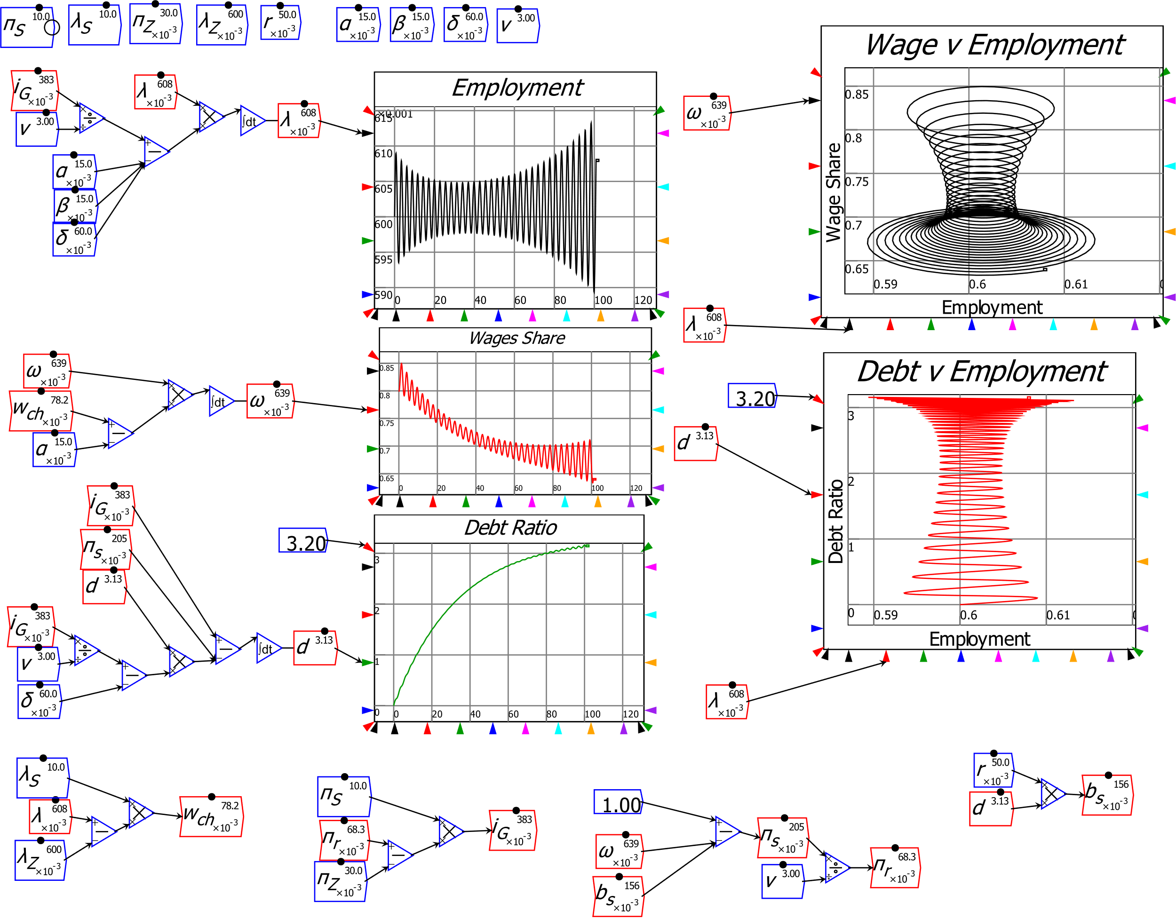
A complex systems foundation for macroeconomics
“Bad” equilibrium: zero employment rate, wages share, infinite debt ratio
High propensity to invest destabilizes the “good” equilibrium…
Highly stylized reproduction of “stylized facts” of last twenty years
Cyclically rising debt ratio
“Calm before the Storm”
“Great Moderation” followed by “Great Recession”
Pomeau-Manneville intermittent route to chaos
Rising inequality

Slide 34
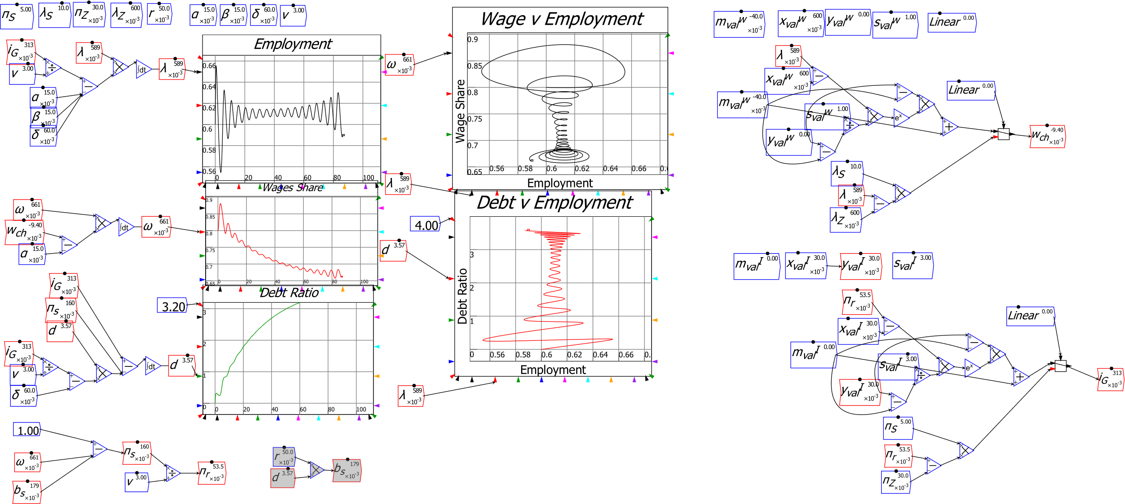
A complex systems foundation for macroeconomics
Nonlinear functions, government, variable capacity can all be added for more realism

Slide 35
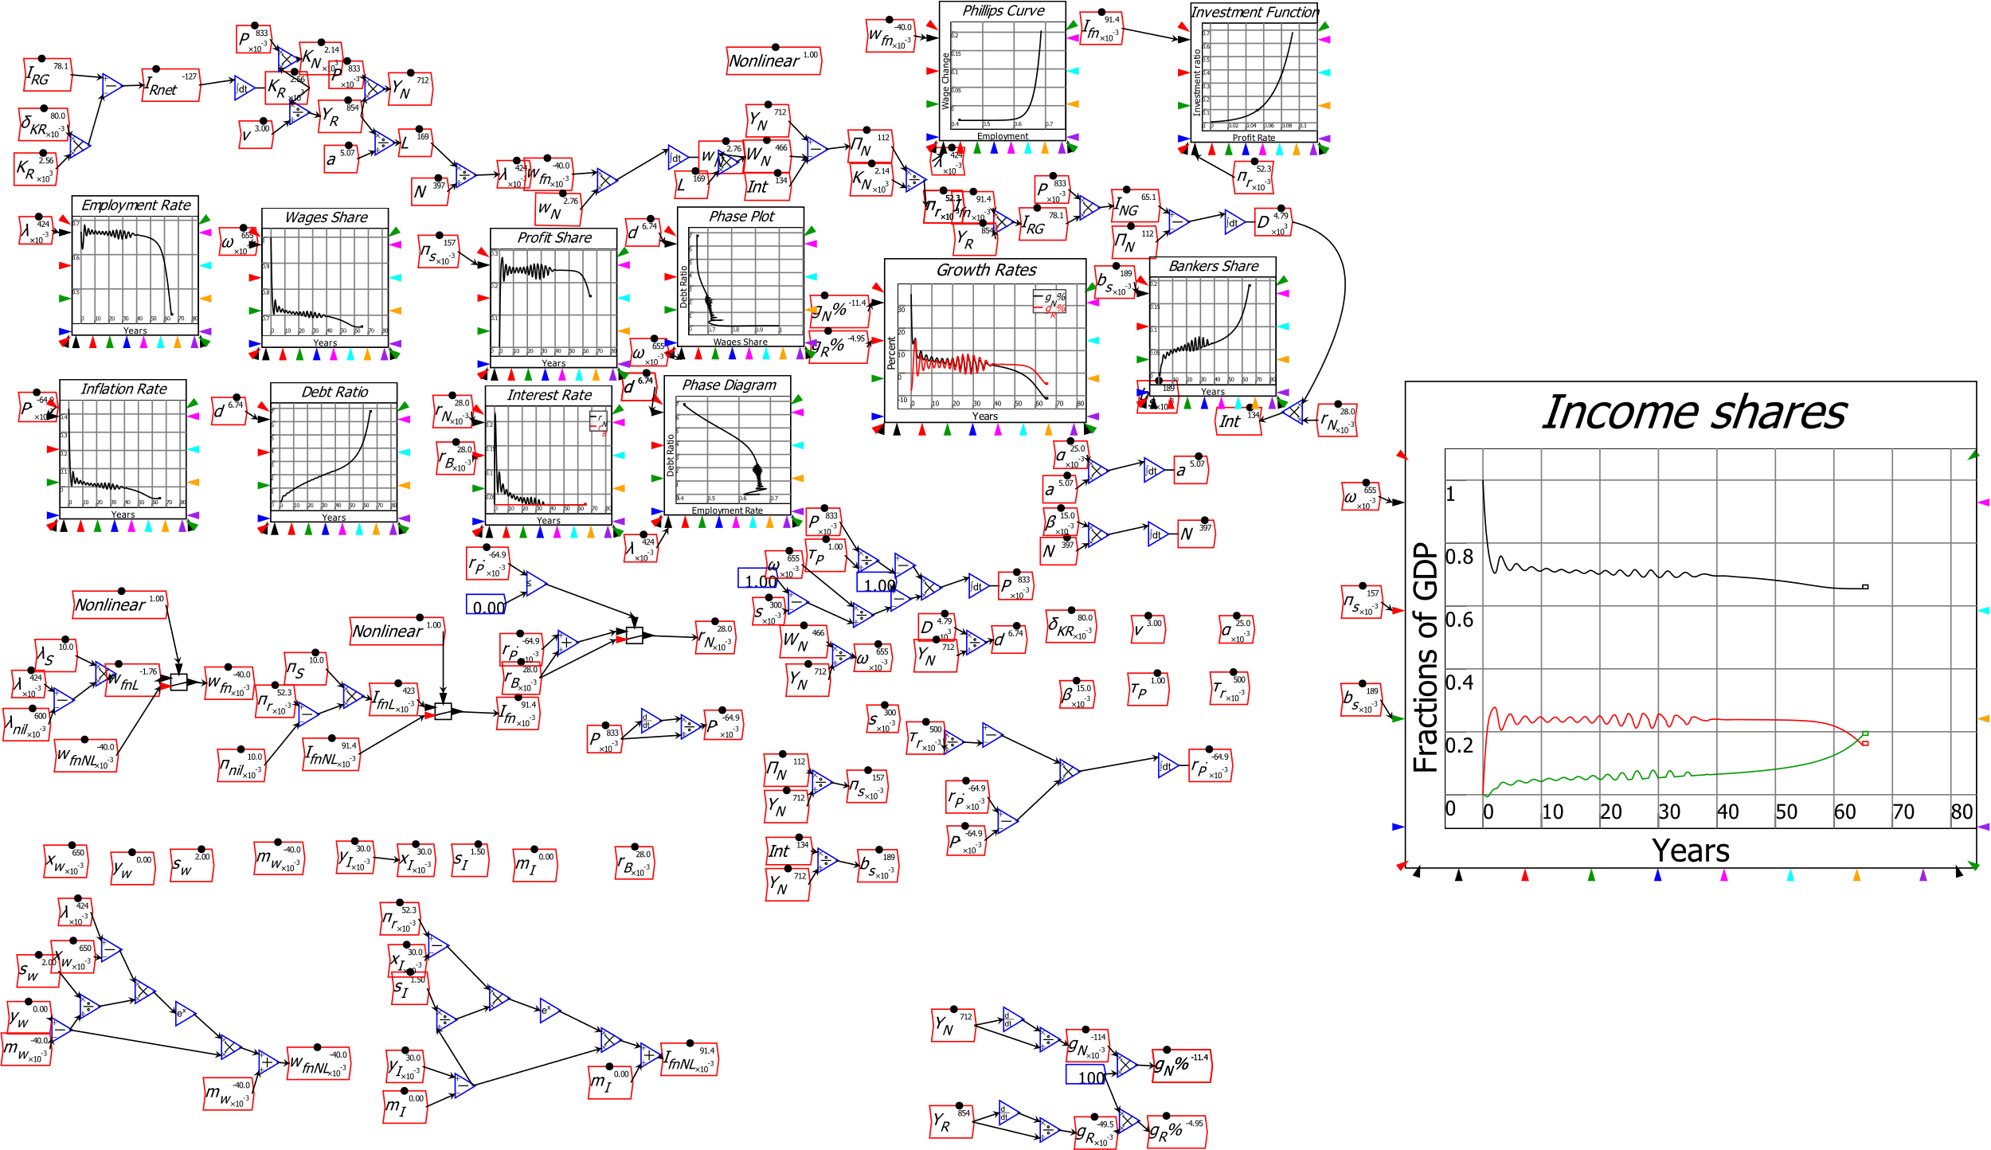
A complex systems foundation for macroeconomics
Model extended by extending definitions: prices, government, etc. (Prices shown here)
May learn more from carefully modelling structure of the economy than from modelling behaviour of agents in it…

Slide 36
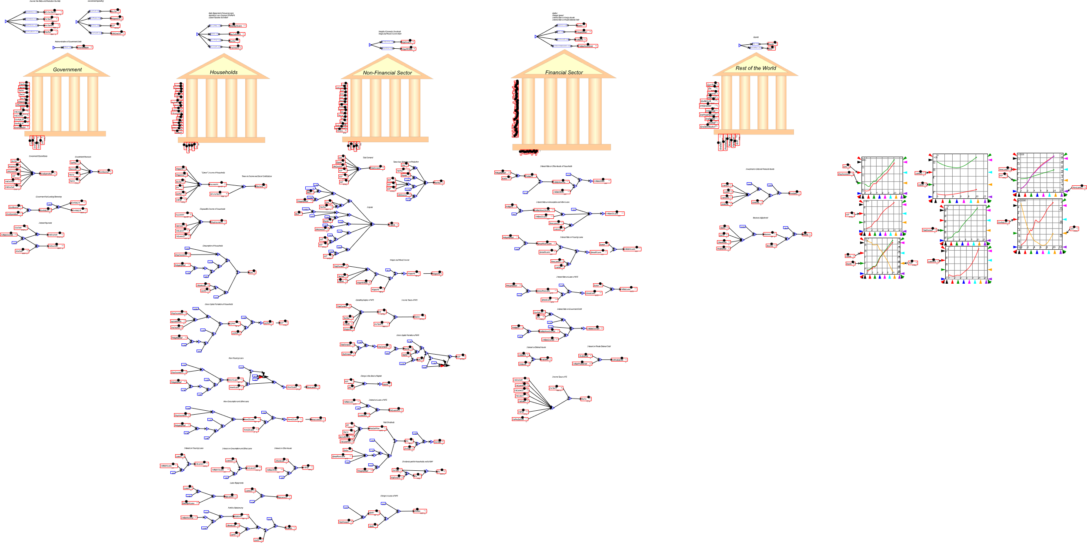
A monetary approach to macroeconomics
General Dynamics: far more elaborate models can be built & simulated:
5 sector model of Portuguese economy (Pratas, Portuguese Statistical Office)

Slide 37
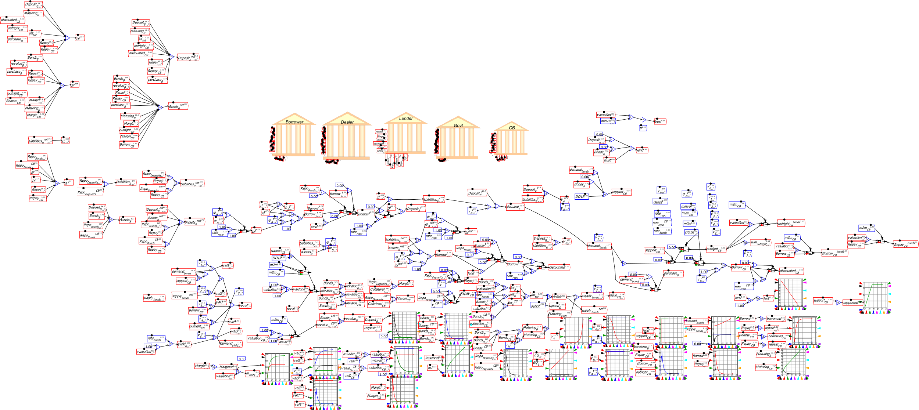
A monetary approach to macroeconomics
Stylized model of shadow banking (Jackson, Bank of England)

Slide 38
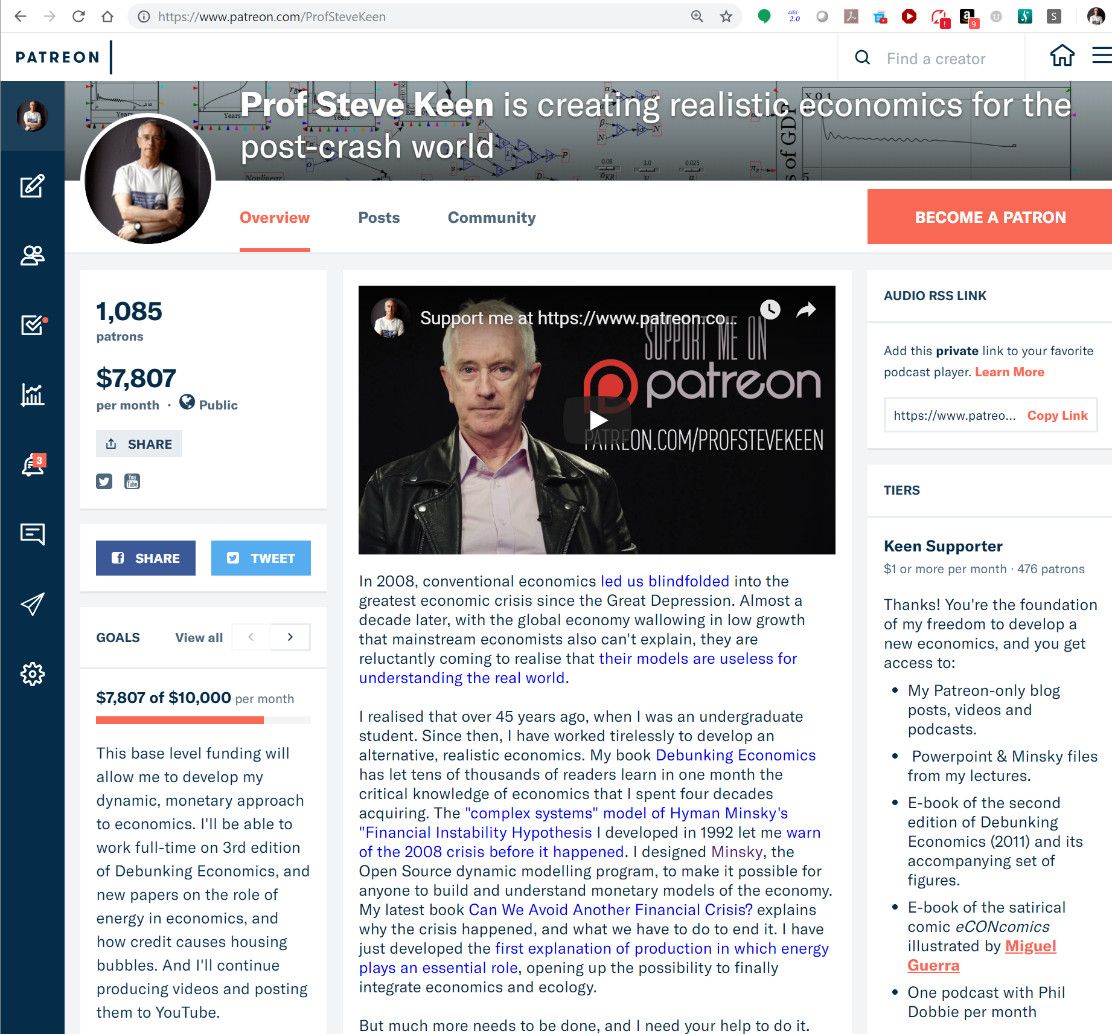
Economics needs to “grow up” & embrace dynamics
“A baby is expected to first crawl, then walk, before running. But what if a grown-up man is still crawling?
At present, the state of our dynamic economics is more akin to a crawl than to a walk, to say nothing of a run.
Indeed, some may think that capitalism as a social system may disappear before its dynamics are understood by economists.” (Blatt in 1982: it’s worse now!)
We need complex systems economics
Universities won’t develop it
  Mainstream excludes alternatives
  Bank of England, World Bank better
And economic rebels like me:
https://www.patreon.com/ProfSteveKeen

